Slide 1
Vocabulary
Unit 8

Slide 2
acrimonious
stinging
Bitter in temper or tone
Biting, rancorous, hostile, peevish
--------------------------------
Gentle, mild, warm, cordial

Slide 3
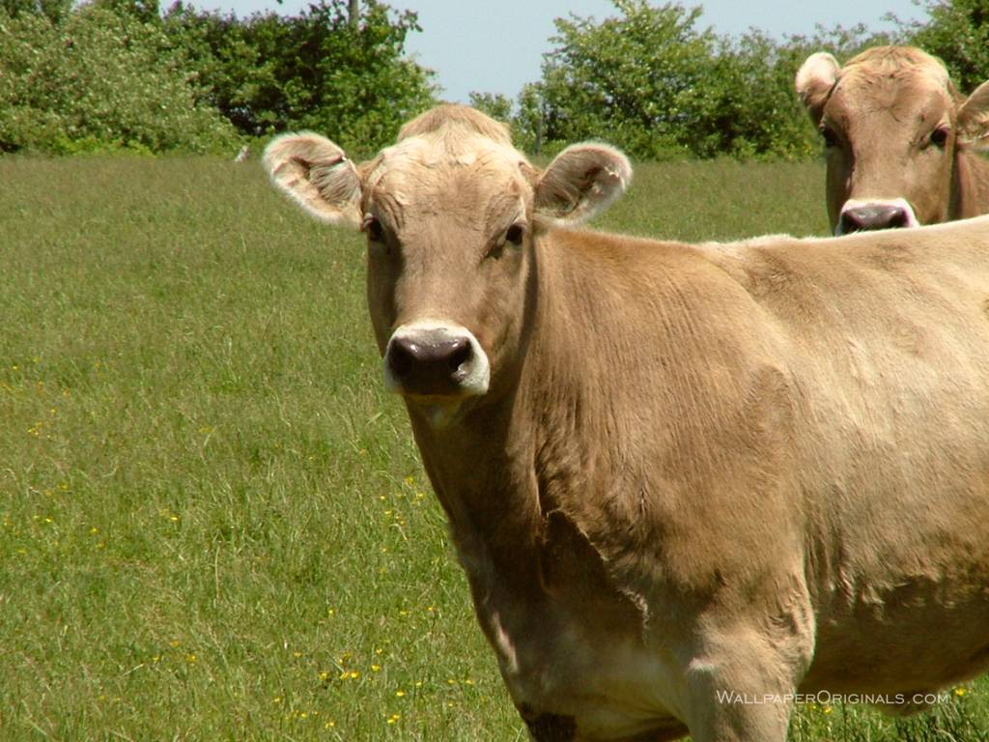
bovine
resembling a cow
sluggish
unresponsive
dull
slow
stupid
--------------------------------
sharp, keen, quick

Slide 4
consternation
dismay
confusion
Bewilderment
Shock, amazement
-----------------------------
calm
composure
aplomb

Slide 5
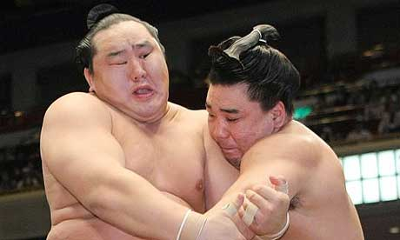
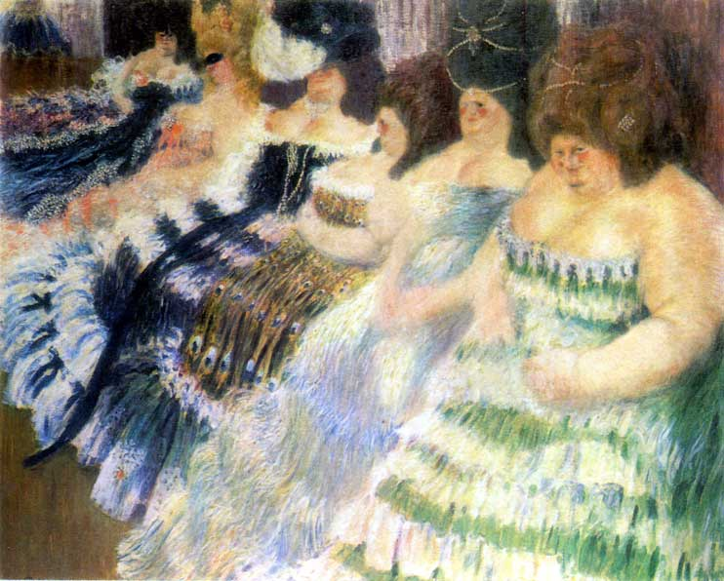
corpulent
fat
having a large, bulky body
overweight
Obese, stout, portly
--------------------------------
Slender, lean, spare
Emaciated, gaunt

Slide 6
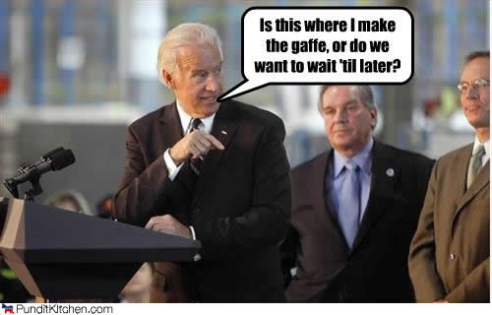
disavow
to deny responsibility for
to deny connection with
disclaim
retract
--------------------------------
Acknowledge, certify
Admit, grant

Slide 7
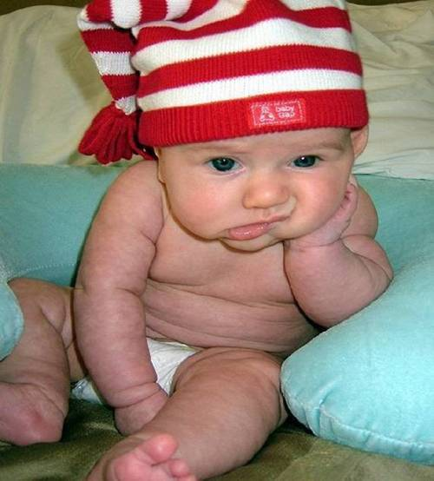
dispassionate
impartial
free from emotion
unbiased
cool
Detached, disinterested
--------------------------------
Committed, engaged
partial
biased

Slide 8
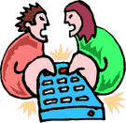
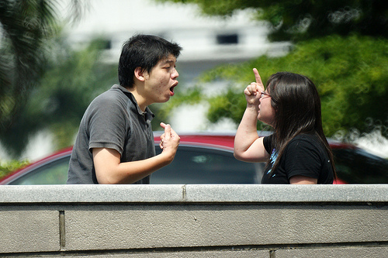
dissension
disagreement
sharp difference of opinion
Strife, discord
contention
--------------------------------
agreement
harmony
accord

Slide 9
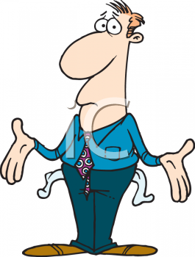
dissipate
to cause to disappear
to spend foolishly
to squander
to waste, disperse, strew, diffuse
--------------------------------
Conserve, gather, collect, husband

Slide 10
expurgate
To remove objectionable passages or words from a written text; to cleanse, purify
Purge, censor, bowdlerize

Slide 11
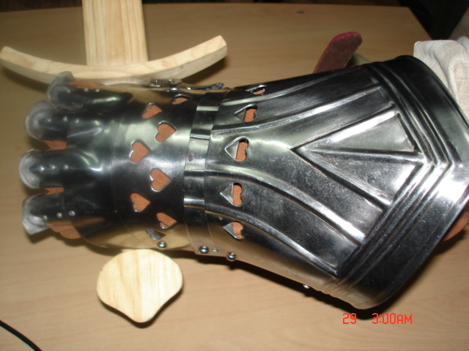
gauntlet
an armored or protective glove
a challenge
Two lines of armed people who beat a person forced to run between them
a dare, provocation
a trial, punishment

Slide 12
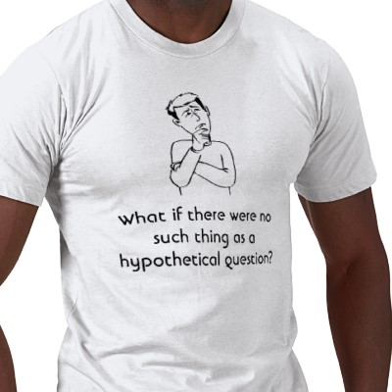
hypothetical
based on an assumption or guess
assumed
conditional
--------------------------------
actual
real
substantiated

Slide 13
ignoble
mean
low
base
inferior
unworthy
--------------------------------
admirable
praiseworthy
noble

Slide 14
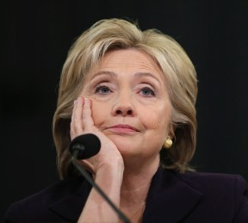
impugn
to call into question
to attack as false
deny
Dispute, challenge
Question, query
--------------------------------
confirm
prove
validate

Slide 15
intemperate
Immoderate; lacking self control; inclement
Excessive, unrestrained, extreme, inordinate
------------------------
Moderate, restrained, collected

Slide 16
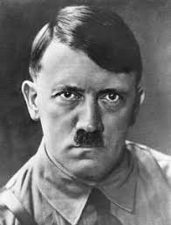
odium
Hatred, contempt
Disgrace or infamy from hateful conduct
Abhorrence, opprobrium, shame, ignominy
----------------------------
Esteem, admiration, approbation

Slide 17
perfidy
Faithlessness, treachery
Betrayal, disloyalty, treason
--------------------------
Faithfulness, loyalty, steadfastness

Slide 18
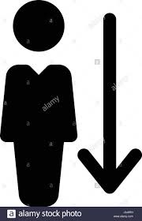
relegate
to place in a lower position
to assign
Transfer
Demote, consign
Banish, exile
--------------------------------
Promote, advance
Elevate; recall

Slide 19
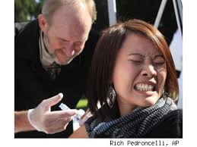
squeamish
inclined to nausea
easily shocked or upset
queasy
oversensitive

Slide 20
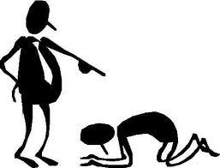
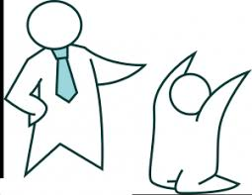
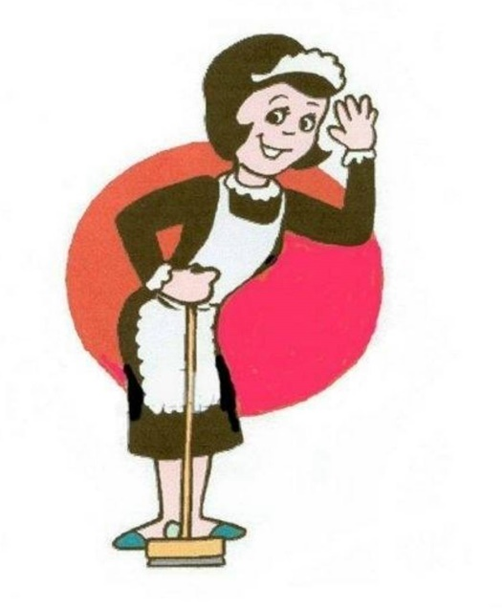
subservient
subordinate in capacity or role
submissively obedient
servile
--------------------------------
primary
domineering

Slide 21
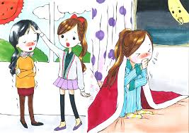
susceptible
open to
easily influenced
lacking in resistance
vulnerable
--------------------------------
resistant
immune

