Slide 1
Vocabulary Unit 7
Level F

Slide 2
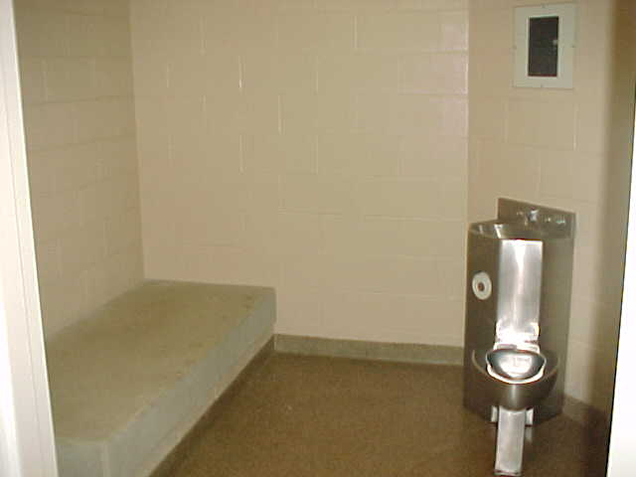
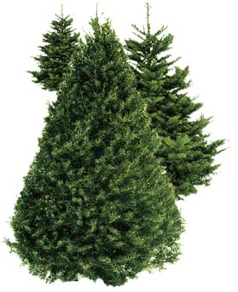
Austere
(adj.)
severe or stern in manner
without adornment or luxury, simple, plain
harsh or sour in flavor
Synonyms: forbidding, rigorous, puritanical, ascetic, unadorned
Antonyms: mild, indulgent, luxurious, flamboyant

Slide 3
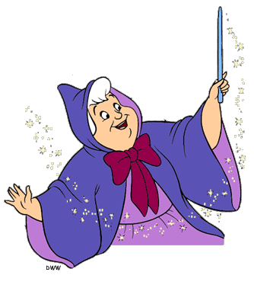
Beneficent
(adj.)
Performing acts of kindness or charity
Conferring benefits, doing good
Syn: humanitarian, magnamimous, charitable
Ant: Selfish, Cruel, harmful, deleterious

Slide 4
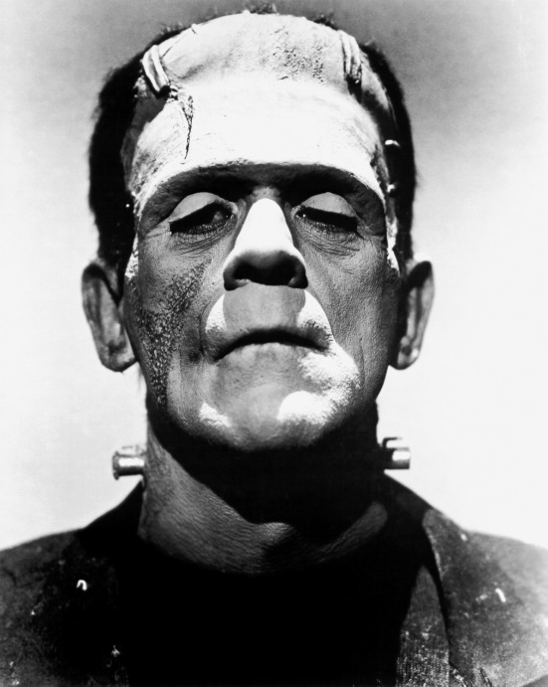
Cadaverous
(adj.)
pale, gaunt, resembling a corpse
Syn: Corpselike, Wasted, haggard, emaciated, ghastly
Ant: Robust, portly, rosy, the picture of health

Slide 5
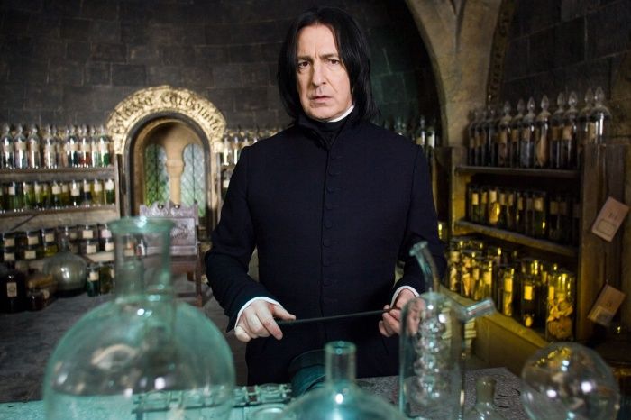
Concoct
(v.)
To prepare by combining ingredients, make up (as a dish)
To devise, invent, fabricate
Syn: create, fashion, rustle up

Slide 6
Crass
(adj.)
coarse, unfeeling
stupid\
Syn: crude, tastless, oafish, obtuse
Ant: refined, elegant, tasteful, polished, brilliant

Slide 7
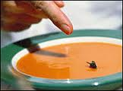
Debase
(v.)
to lower in character, quality, or value
to degrade, adulterate
to cause to deteriorate
Synonyms: Cheapen, corrupt, demean, depreciate,
Ant: elevate, uplift, improve, enhance

Slide 8
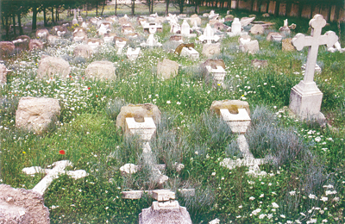
Desecrate
(v.)
to commit sacrilege upon, treat irreverently
to contaminate, pollute
Syn: Profane, defile, violate
Ant: revere, venerate, consecrate

Slide 9
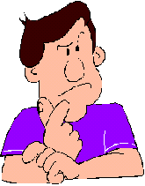
Disconcert
(v.)
to confuse
to disturb the composure of
Syn: Upset, rattle, ruffle, faze
Ant: Relax, calm, put at ease
https://www.youtube.com/watch?v=uT3SBzmDxGk

Slide 10
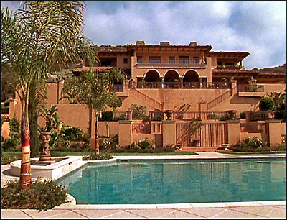
Grandiose
(adj.)
grand in an impressive or stately way
marked by pompous affectation or grandeur, absurdly exaggerated
Synonym: Majestic, bombastic, highfalutin
Ant: Simple, Modest, Humble

Slide 11
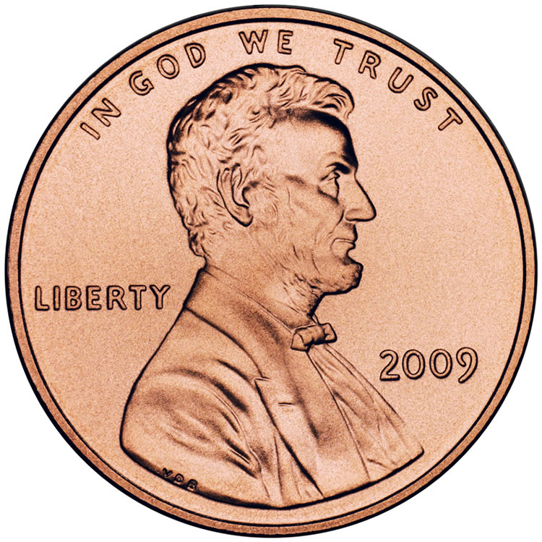
Inconsequential
(adj.)
Trifling, unimportant
Synonym: trivial, negligible, paltry
Antonym: important, essential, crucial

Slide 12
Infraction
(n.)
a breaking of a law or obligation
Synonyms: violation, transgression, offense

Slide 13
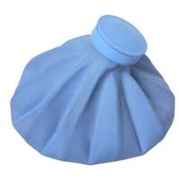
Mitigate
(v.)
To make milder or softer, to moderate in force or intensity
Synonyms: lessen, relieve, alleviate
Antonyms: aggravate, intensify, irritate, exacerbate

Slide 14
Pillage
(v.)
to rob of goods by open force (as in war), plunder
(n.)
the act of looting
Booty
Synonyms: (v) ravage, sack, loot; (n) booty

Slide 15
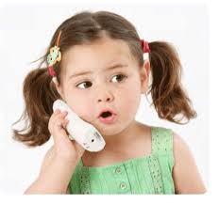
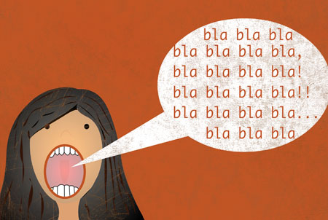
Prate
(v.)
to talk a great deal in a foolish or aimless fashion
Synonyms: prattle, blab, palaver
Antonyms: come to the point

Slide 16
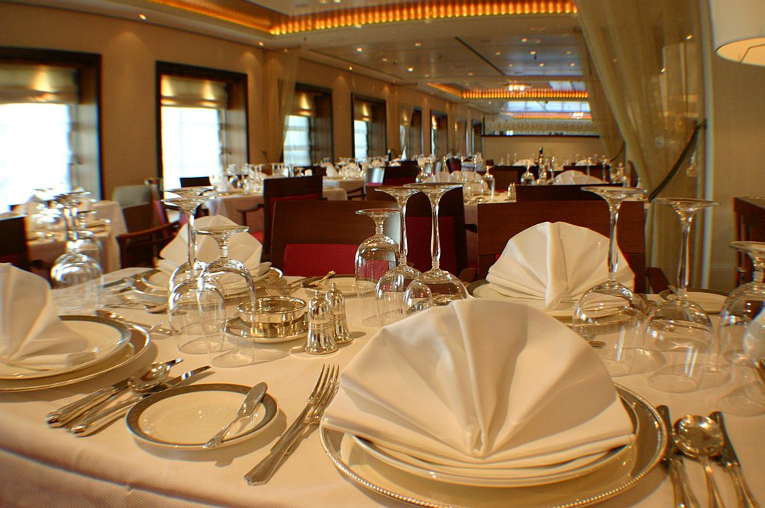
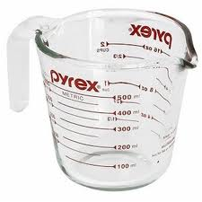
Punctilious
(adj.)
Very careful and exact, attentive to fine points of etiquette or propriety
Synonyms: precise, scrupulous
Antonyms: careless, perfunctory

Slide 17
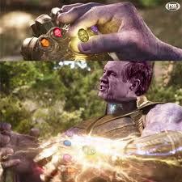
Redoubtable
(adj.)
Inspiring fear or awe
Illustrious, eminent
Synonyms: formidable, august
Antonyms: laughable, risible

Slide 18
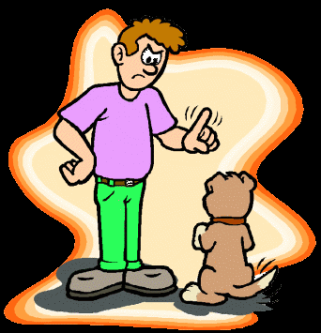
Reprove
(v.)
To find fault with, scold, rebuke
Synonyms: chastise, upbraid, reproach
Antonyms: praise, commend, laud, pat on the back

Slide 19
Restitution
(n.)
the act of restoring someone or something to the rightful owner or to a former state or position
making good on a loss or damage
Synonyms: reimbursement, redress, restoration

Slide 20
Stalwart
(adj.)
Strong and sturdy
Brave
Resolute
(n.)
A brave, strong person
A strong supporter
One who takes an uncompromising position
Synonyms: sturdy, stout, intrepid, valiant; mainstay
Antonyms: weak, inform, irresolute; vacillating

Slide 21
Vulnerable
(adj.)
open to attack
capable of being wounded or damaged
Unprotected
Synonyms: defenseless, unguarded
Antonyms: invincible, protected, safe, secure

