Slide 1
Unit 6A Vocab Words

Slide 2
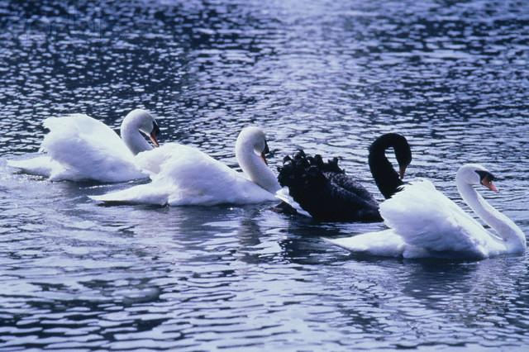
Anomalous (adj.)
Definition: abnormal, irregular, departing from the usual
Synonyms: exceptional, unusual, aberrant
Antonyms: normal, regular, customary, typical, ordinary

Slide 3
Aspersion (n.)
Definition: a damaging or derogatory statement; the act of slandering
Synonyms: innuendo, calumny
Antonyms: endorsement, praise

Slide 4
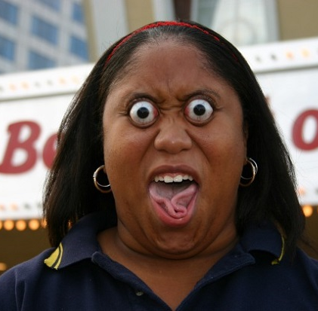
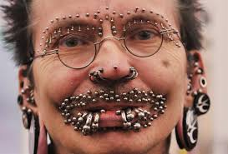
Bizarre (adj.)
Definition: extremely strange, unusual, atypical
Synonyms: grotesque, fantastic, outlandish
Antonyms: normal, typical, ordinary, expected

Slide 5
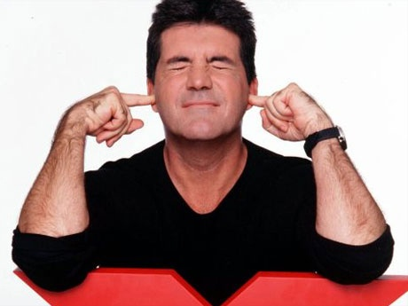
Brusque (adj.)
Definition: abrupt, blunt, with no formalities
Synonyms: tactless, ungracious
Antonyms: tactful, diplomatic

Slide 6
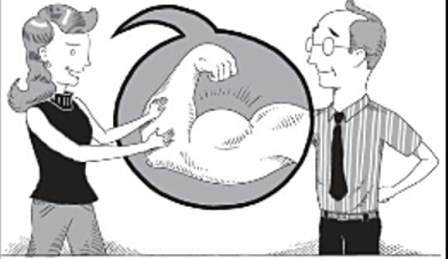
Cajole (v.)
Definition: to coax, persuade through flattery or artifice; to deceive with soothing thoughts or false promises
Synonyms: wheedle, inveigle
Antonyms: coerce, force

Slide 7
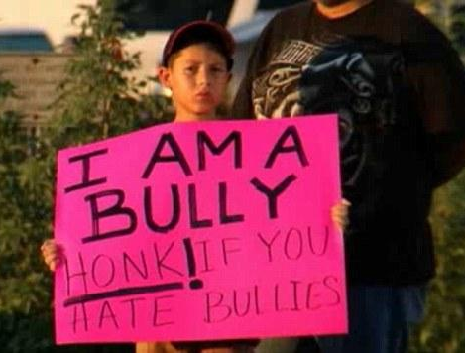
Castigate (v.)
Definition: to punish severely; to criticize severely
Synonyms: chastise, censure
Antonyms: honor, praise, laud

Slide 8
Contrive (v.)
Definition: to plan with ingenuity, invent; to bring about as the result of a scheme or plan
Synonyms: concoct, fabricate, think up
Antonyms:

Slide 9
Demagogue (n.)
Definition: a leader who exploits popular prejudices and uses false claims and promises in order to gain power.
Synonyms: rebel-rouser, firebrand
Antonyms:

Slide 10
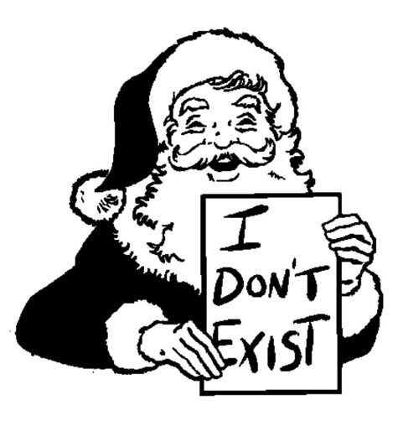
Disabuse (v.)
Definition: to free from deception or error, set right in ideas or thinking
Synonyms: undeceive, enlighten
Antonyms: deceive, delude

Slide 11
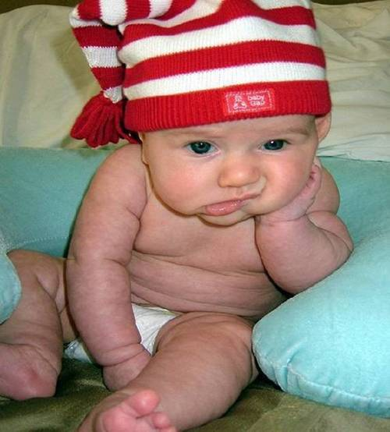
Ennui (n.)
Definition: weariness and dissatisfaction from lack of occupation or interest; boredom
Synonyms: languor, world-weariness, listlessness
Antonyms: enthusiasm, liveliness, excitement, intensity

Slide 12
Unit 6B Vocab Words

Slide 13
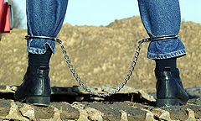
Fetter (n. or v.)
Definition: n. a chain or shackle placed on the feet; anything that confines or restrains
v. To chain or shackle; to render helpless
Synonyms: n. bond, restraint
v. bind, hamper
Antonyms: v. free, liberate, emancipate

Slide 14
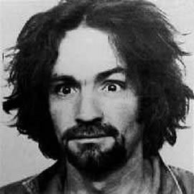
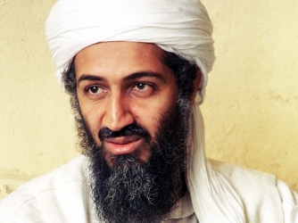
Heinous (adj.)
Definition: very wicked, offensive, hateful
Synonyms: evil, odious, abominable, outrageous
Antonyms: excellent, wonderful

Slide 15
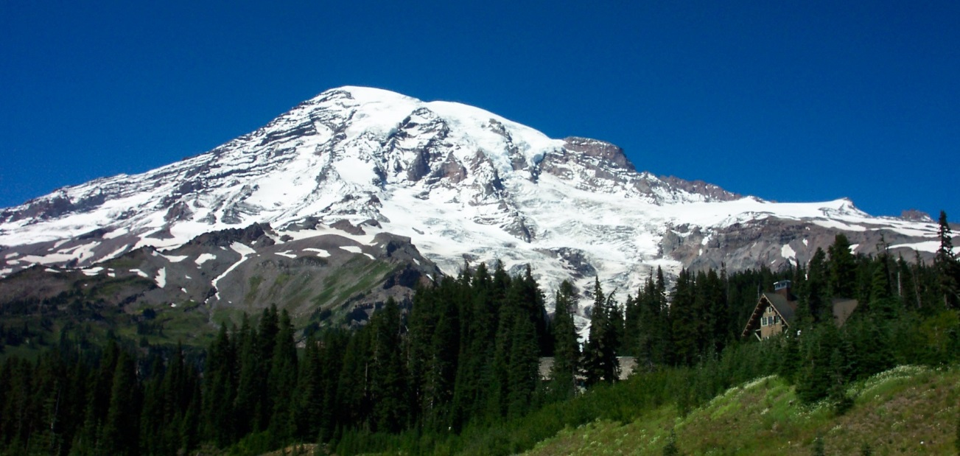
Immutable (adj.)
Definition: not subject to change, constant
Synonyms: unchangeable, unalterable, fixed
Antonyms: changeable, inconstant, variable, fickle

Slide 16
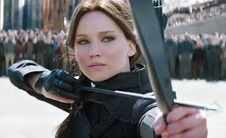
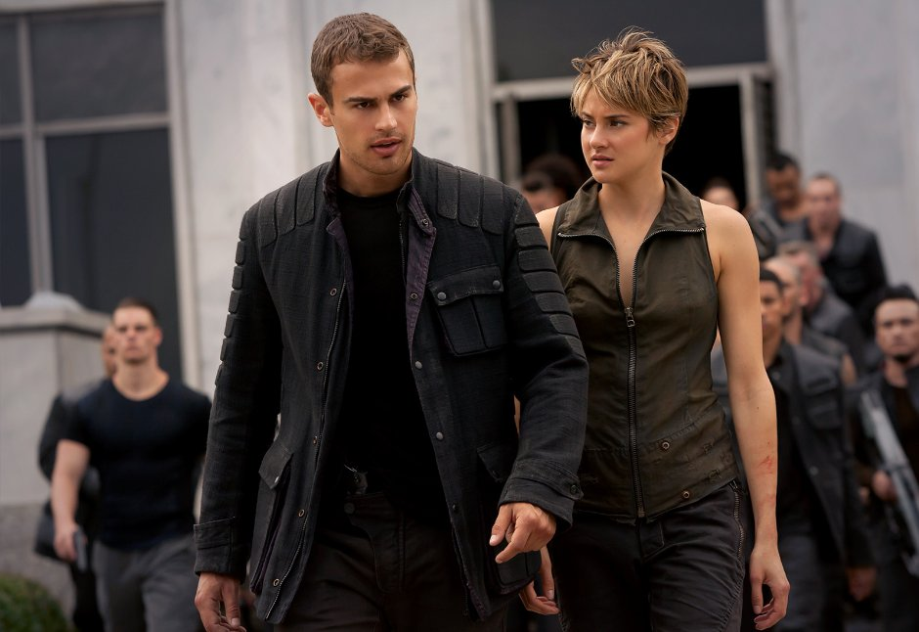
Insurgent (n. or adj.)
Definition: n. one who rebels or rises against authority
adj. Rising in revolt; refusing to accept authority, surging or rushing in or on
Synonyms: n. rebel, mutineer
adj. revolutionary, rebellious, mutinous
Antonyms: n. supporter
adj. loyalist, loyal, faithful

Slide 17
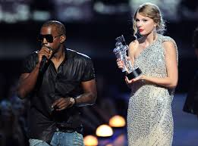
Megalomania (n.)
Definition: a delusion marked by a feeling of power, wealth, talent, etc., far in excess or reality
Synonyms: overbearingness
Antonyms: humility, modesty, self abasement

Slide 18
Sinecure (n.)
Definition: a position requiring little or no work; an easy job
Synonyms: cushy job
Antonyms:
TEACHING!

Slide 19
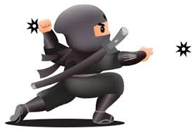
Surreptitious (adj.)
Definition: stealthy, secret, intended to escape observation; made or accomplished by fraud
Synonyms: furtive, covert, clandestine, concealed
Antonyms: open, frank, overt

Slide 20
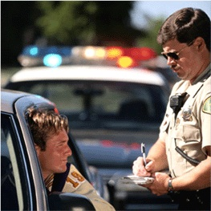
Transgress (v.)
Definition: to go beyond a limit or boundary; to sin, violate a law
Synonyms: overstep, exceed, trespass
Antonyms: obey

Slide 21
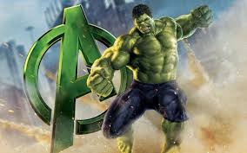
Transmute (v.)
Definition: to change from one nature, substance or form to another
Synonyms: transform, convert, translate, metamorphose
Antonyms:

Slide 22
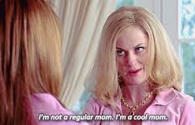
Vicarious (adj.)
Definition: performed, suffered, or otherwise experienced by one person in place of another
Synonyms: surrogate, substitute, imagined, secondhand
Antonyms:

