Slide 1
Unit 3A Vocab Words

Slide 2
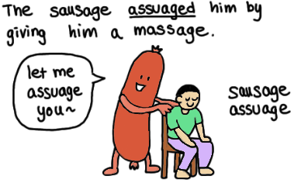
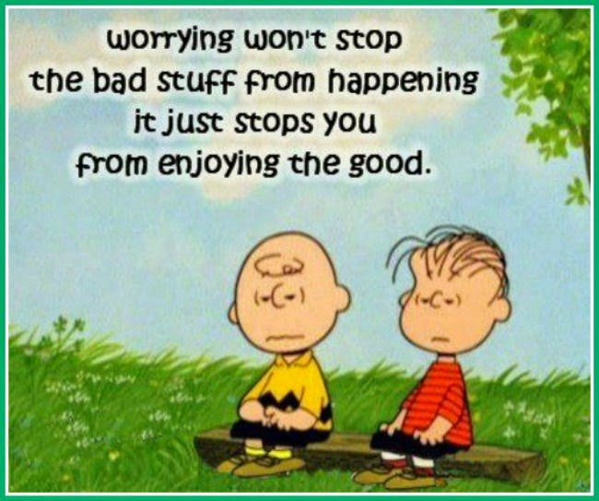
assuage (v.)
Definition: make (an unpleasant feeling) less intense
Synonyms: soothe; relieve

Slide 3
auspicious (adj.)
Definition: conducive to success; favorable
Synonyms: promising

Slide 4
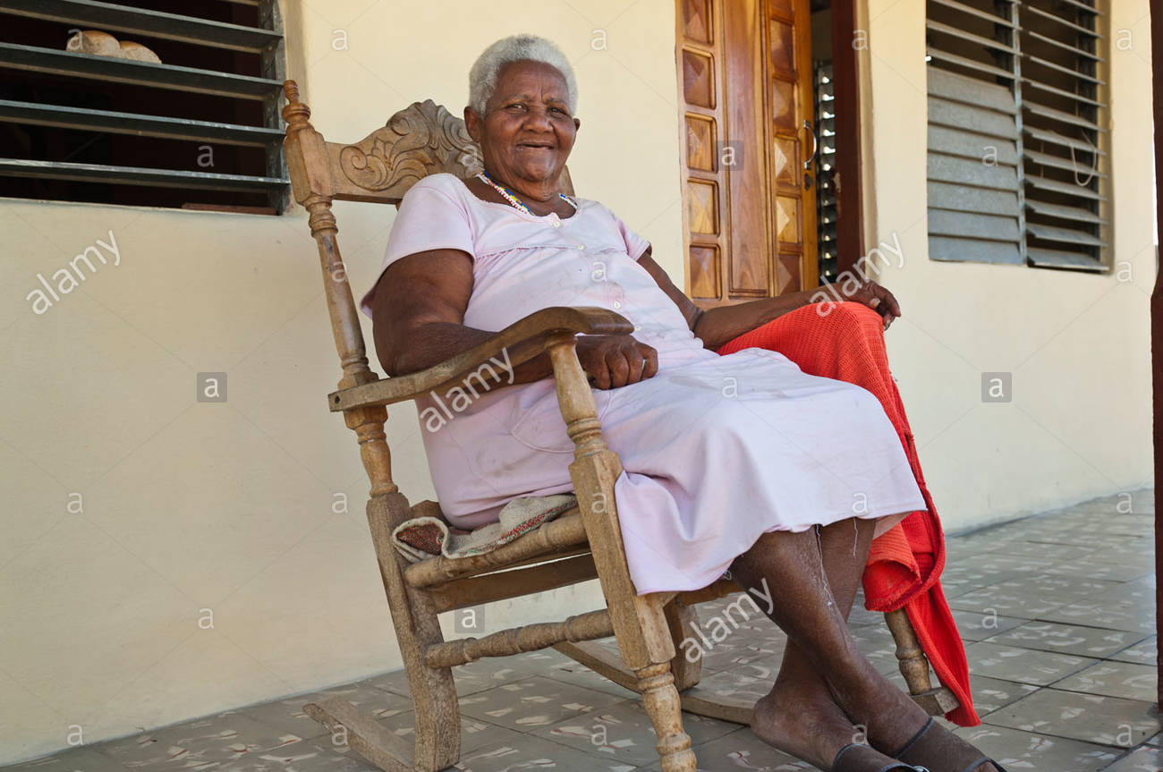
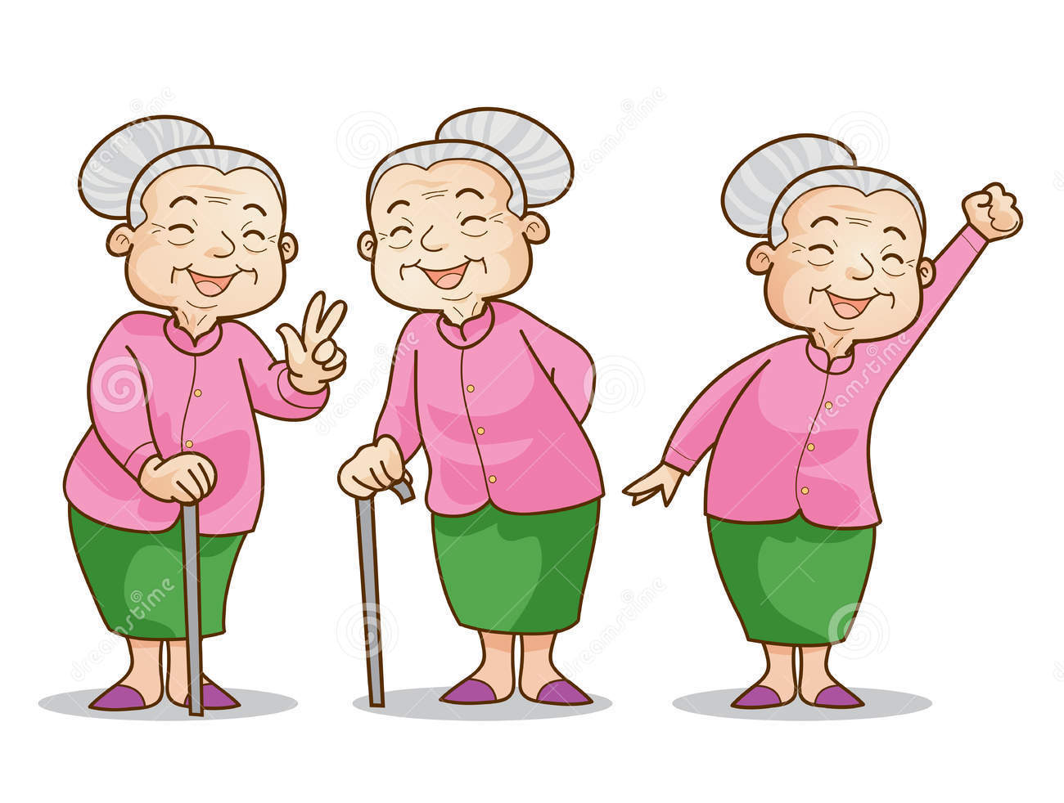
benign (adj.)
Definition: harmless; gentle and kind
Synonyms: kindly

Slide 5
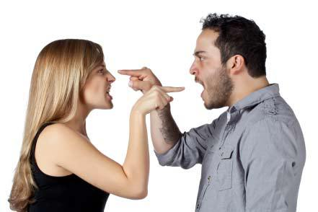
contentious (adj.)
Definition: quarrelsome, inclined to argue
Synonyms: controversial

Slide 6
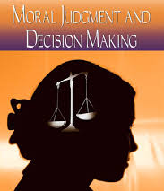
disapprobation (n.)
Definition: strong disapproval, typically on moral grounds
Synonyms: disapproval

Slide 7
edification (n.)
Definition: the instruction or improvement of a person morally or intellectually
Synonyms: education

Slide 8
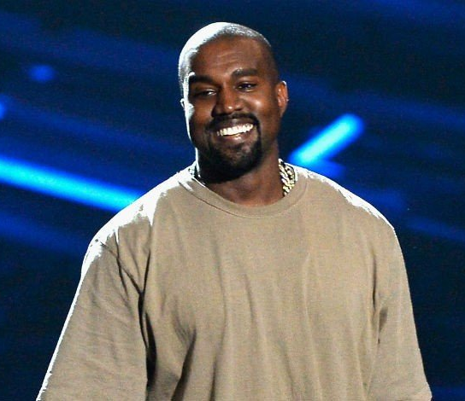
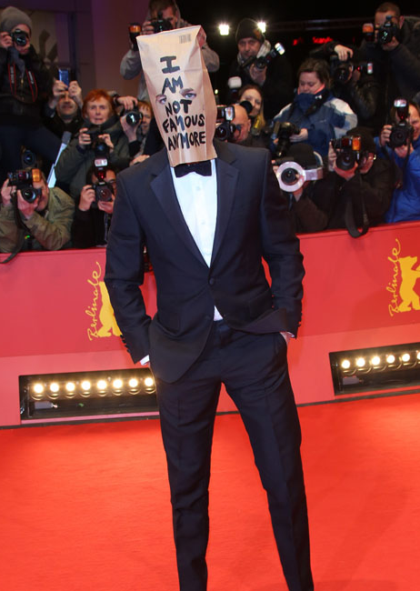
erratic (adj.)
Definition: irregular, unpredictable
Synonyms: inconsistent

Slide 9
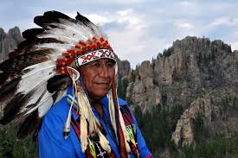
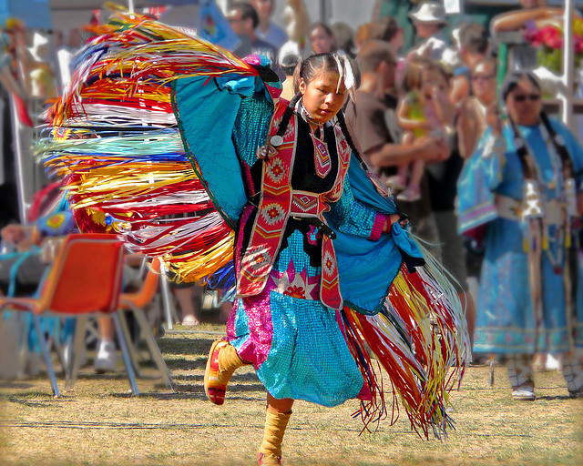
indigenous (adj.)
Definition: originating from a certain area
Synonyms: native

Slide 10
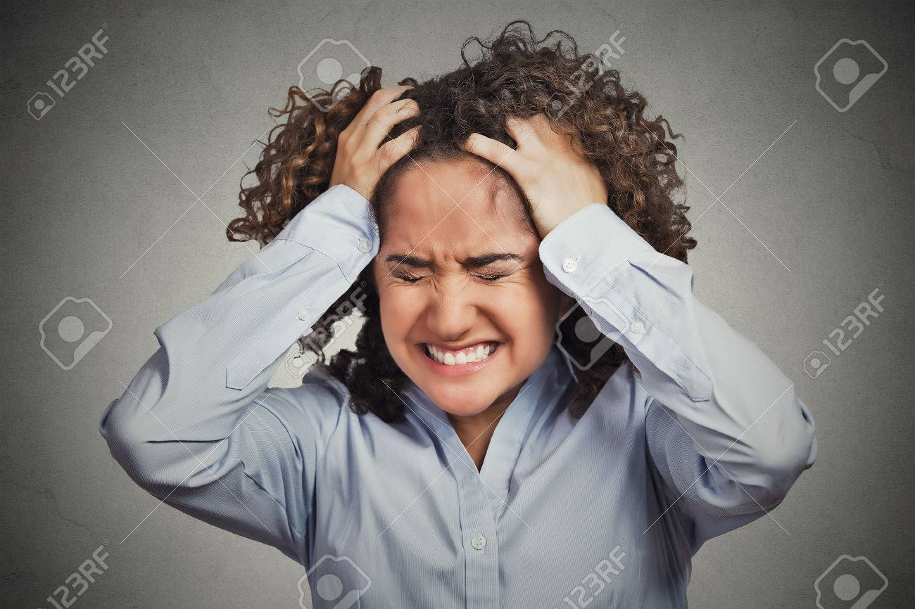
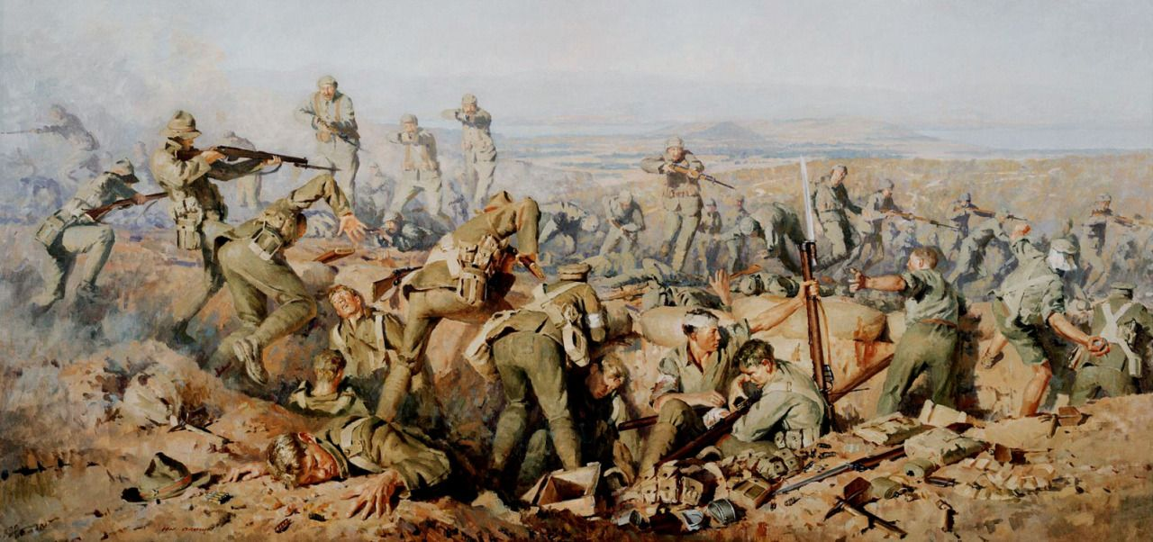
onslaught (n.)
Definition: a violent attack; a sudden rush of something
Synonyms: assault

Slide 11
persevere (v.)
Definition: continue in a course of action in the face of difficulty with little or no prospect of success
Synonyms: persist; keep going

Slide 12
Unit 3B Vocab Words

Slide 13
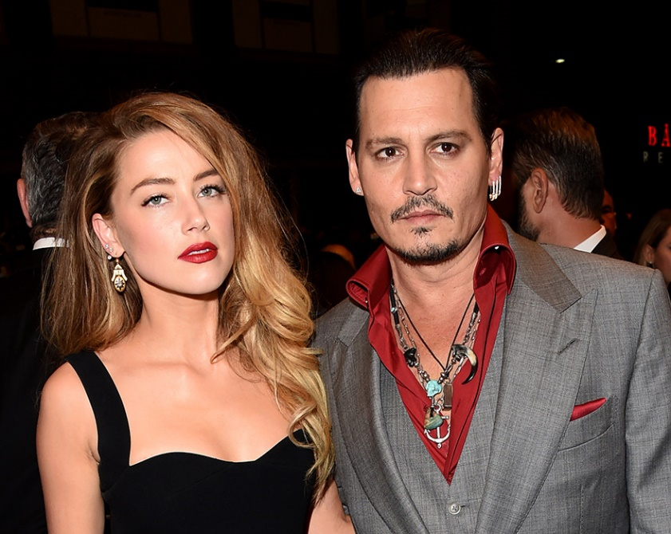
acrimonious (adj.)
Definition: angry and bitter
Synonyms: bitter, scathing

Slide 14
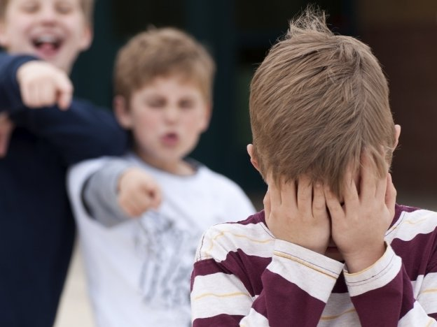
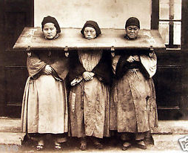
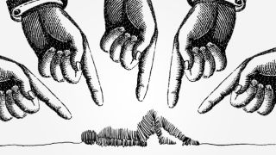
degradation (n.)
Definition: the process of being dishonored
Synonyms: humiliation, shame

Slide 15
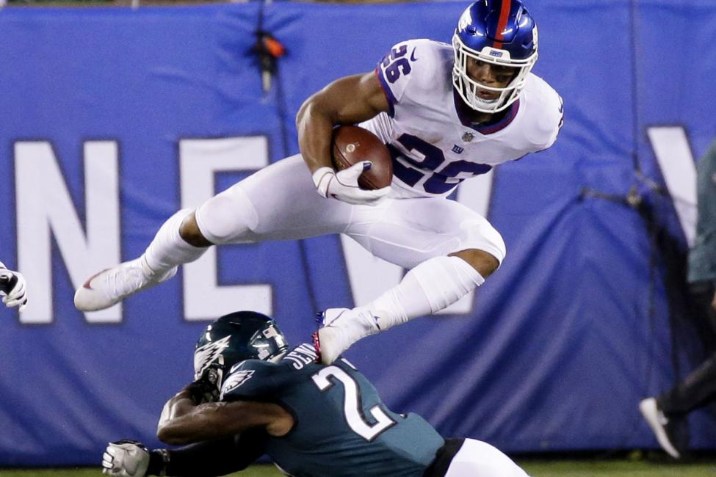
formidable (adj.)
Definition: inspiring fear or respect through being impressively large, powerful, intense or capable
Synonyms: intimidating, daunting

Slide 16
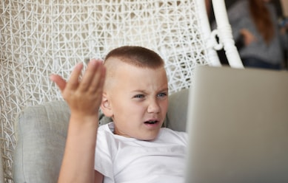
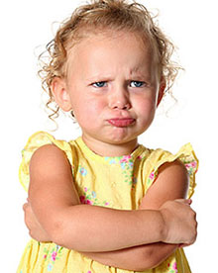
indignantly (adv.)
Definition: in a manner indicating anger or annoyance at something perceived as unfair
Synonyms: resentfully, crossly

Slide 17
infallible (adj.)
Definition: incapable of making mistakes or being wrong
Synonyms: unfailing, flawless

Slide 18
ominous (adj.)
Definition: giving the impression that something bad or unpleasant is going to happen
Synonyms: threatening, sinister, foreboding,menacing

Slide 19
prosperity (n.)
Definition: the state of being prosperous (well-off)
Synonyms: wealth, success, affluence

Slide 20
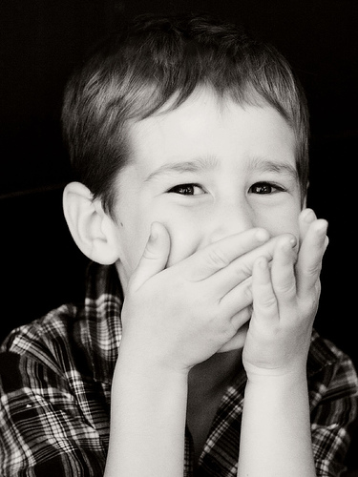
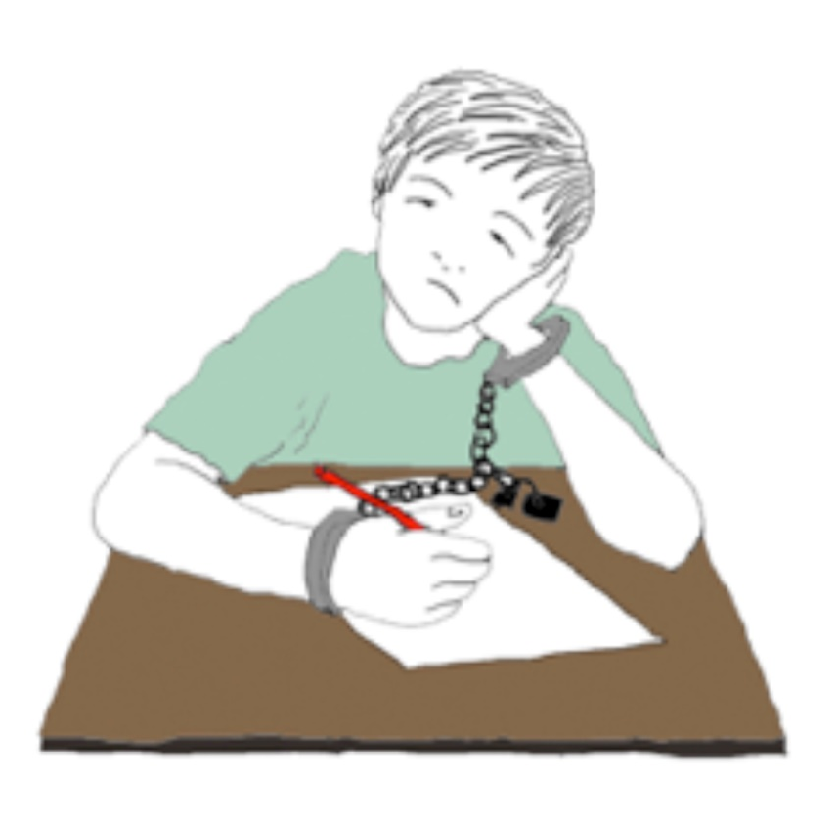
stifle (v.)
Definition: restrain a reaction or an emotion
Synonyms: suffocate, suppress

Slide 21
strenuous (adj.)
Definition: requiring or using great exertion
Synonyms: demanding, tough, arduous

Slide 22
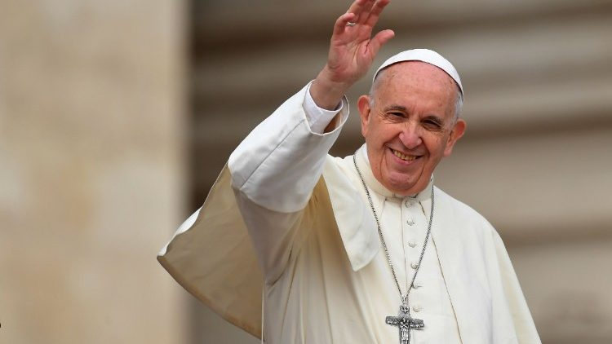
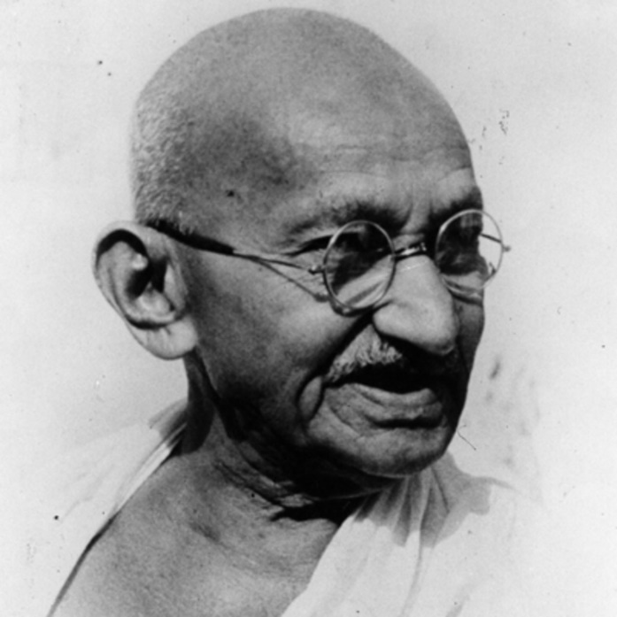
venerable (adj.)
Definition: accorded a great deal of respect, especially because of age, wisdom, or character
Synonyms: respected, revered

