Slide 1
Springboard Unit 1A & 2A, Coming of Age:
QUESTION, HEARD, TEACH
inconspicuous | bizarre | nostalgia | grit | vague
poignant | reverie | lulled | monotonous | elude
Q: Words I QUESTION or don’t know
H: Words I have HEARD
T: Words I could TEACH

Slide 2
Unit 1A Vocab Words

Slide 3
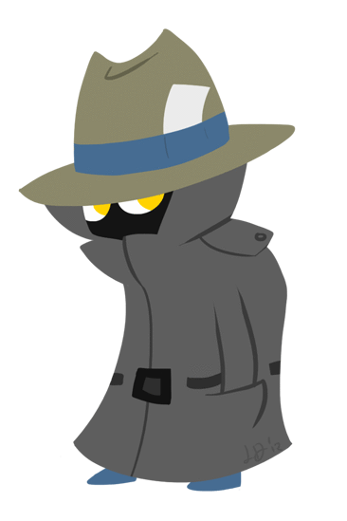
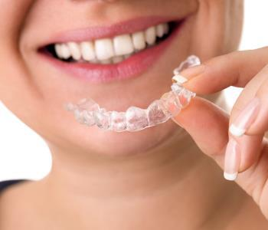
inconspicuous (adj.)
Definition: not clearly visible; avoiding attention
Synonyms: unnoticeable

Slide 4
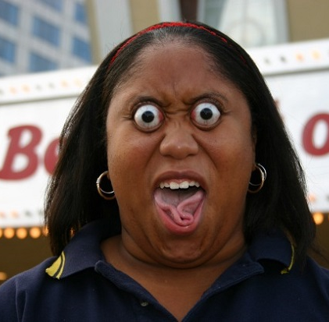
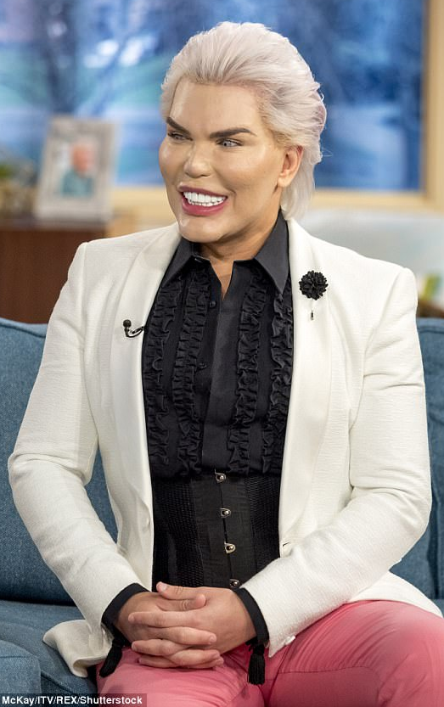
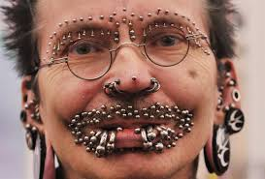
bizarre (adj.)
Definition: very strange or unusual
Synonyms: abnormal

Slide 5
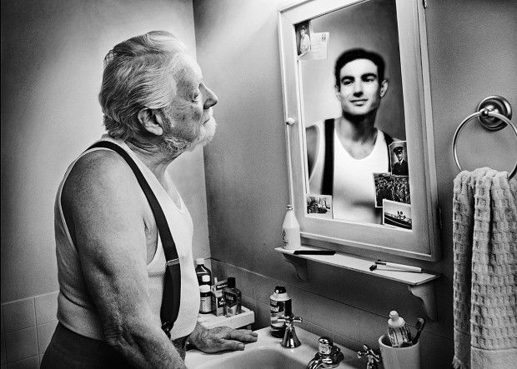
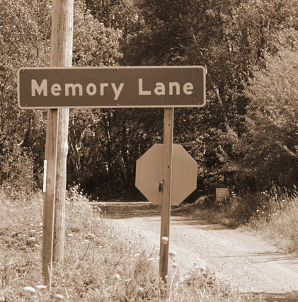
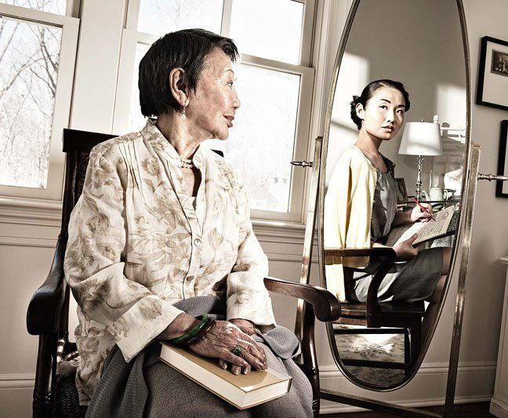
nostalgia (n.)
Definition: a sentimental longing for the past, typically for a time or place with happy personal memories
Synonyms: wistfulness

Slide 6
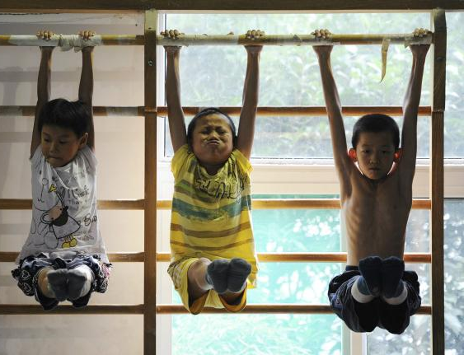
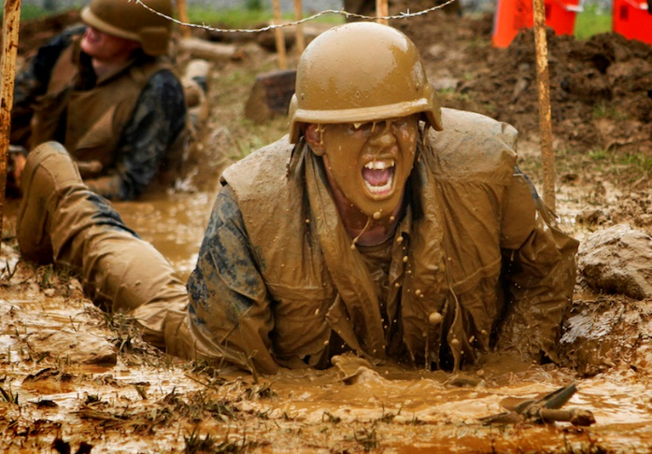
grit (n.)
Definition: courage and determination; strength of character
Synonyms: resolve

Slide 7
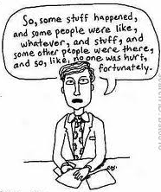
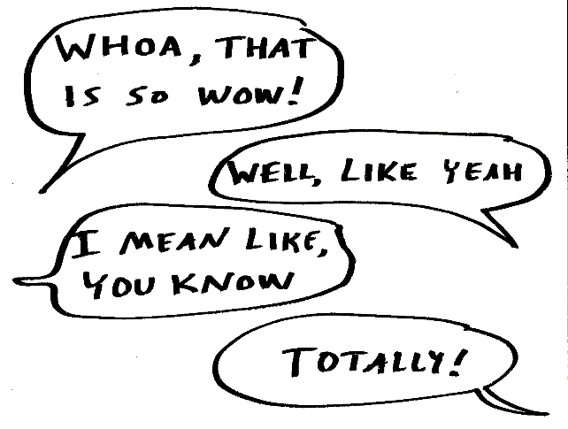
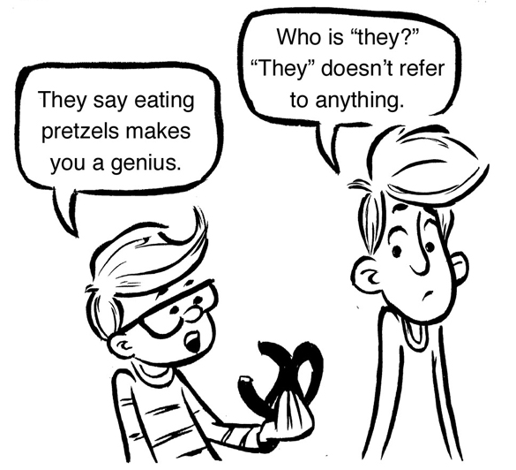
vague (adj.)
Definition: not communicating clearly
Synonyms: imprecise

Slide 8
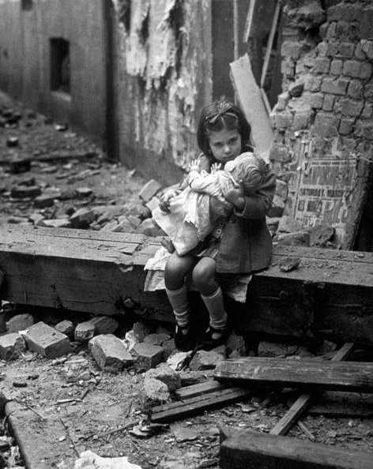
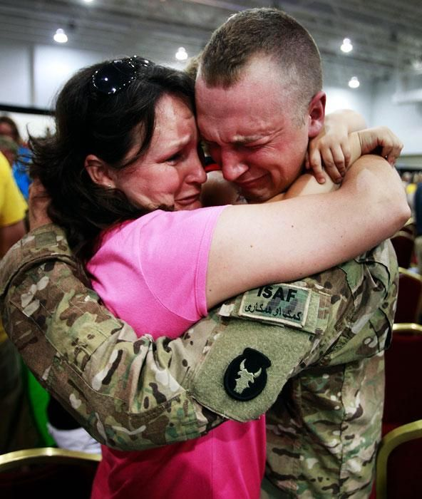
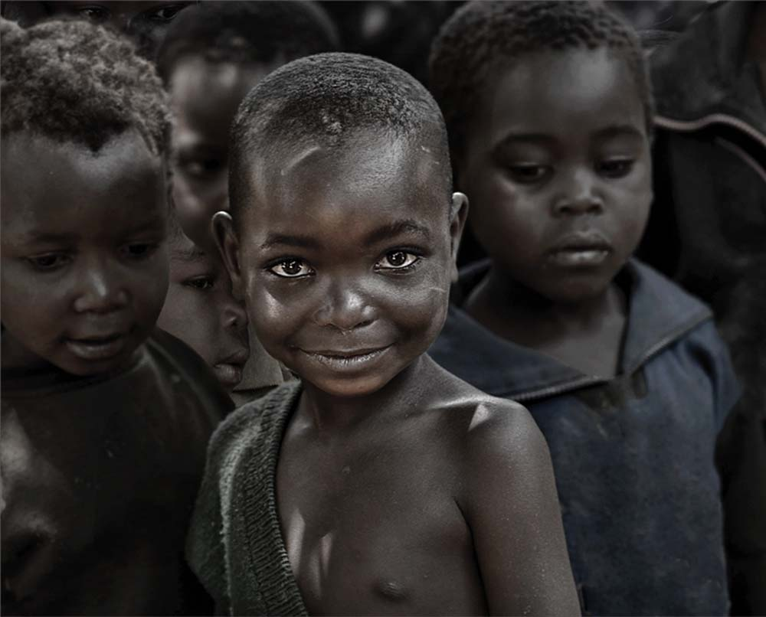
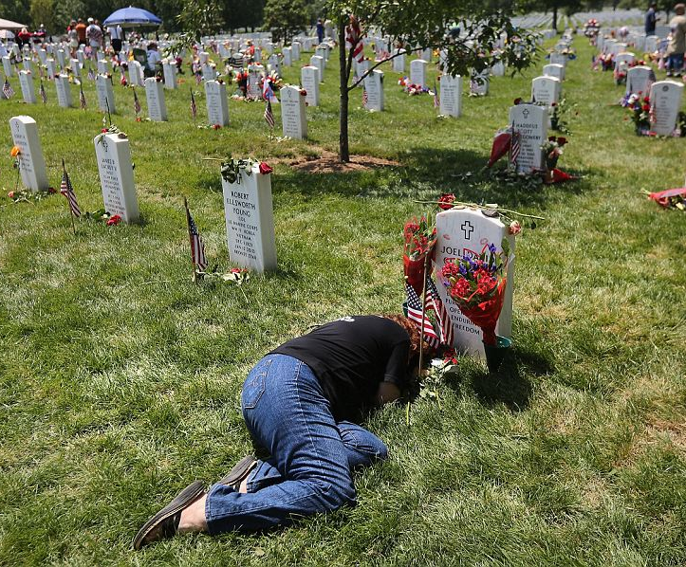
poignant (adj.)
Definition: in a deeply emotional way; designed to evoke strong emotions like sorrow, sympathy or regret
Synonyms: touching; heartbreaking

Slide 9
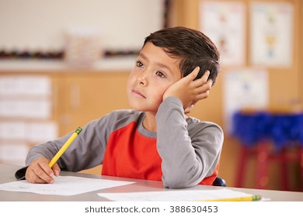
reverie (n.)
Definition: a state of being pleasantly lost in one's thoughts
Synonyms: daydream

Slide 10
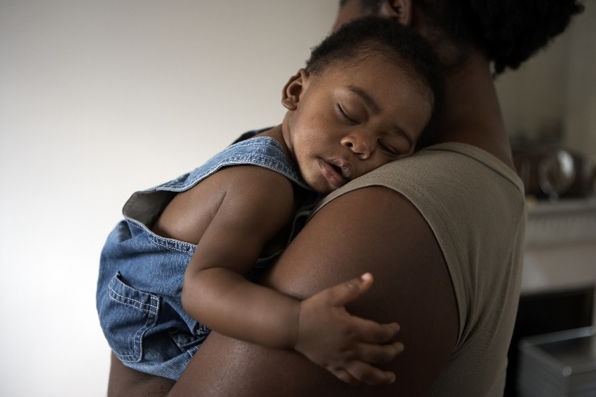
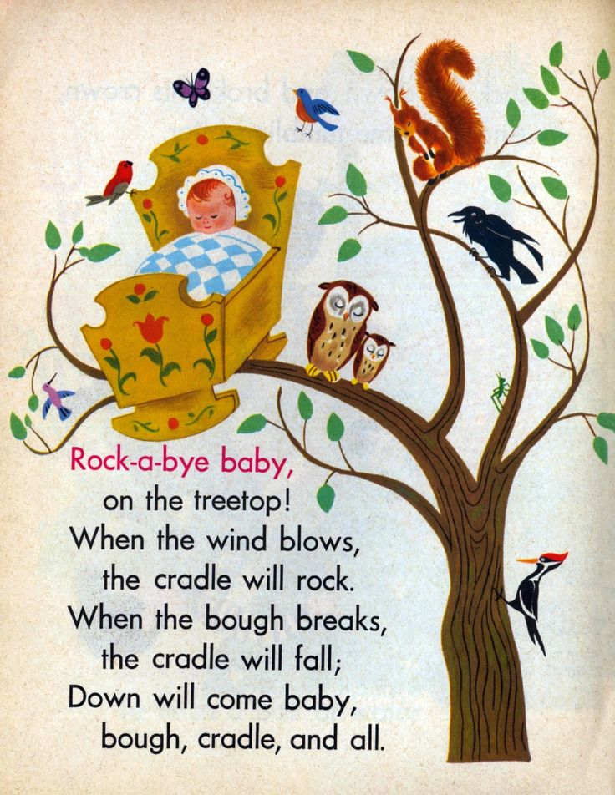
lulled (v.)
Definition: to calm or send to sleep, typically with soothing sounds or movements
Synonyms: soothe

Slide 11
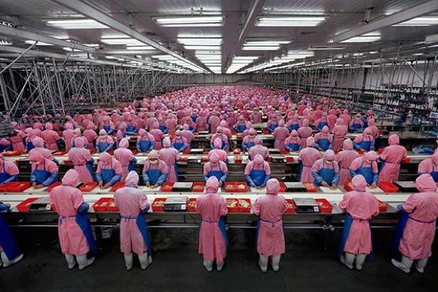
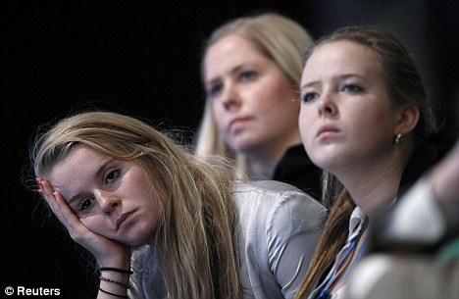
monotonous (adj.)
Definition: dull, tedious, and repetitive; lacking in variety and interest
Synonyms: boring; uninteresting

Slide 12
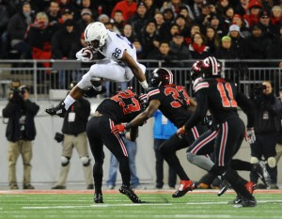
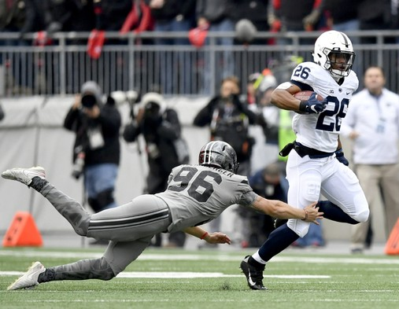
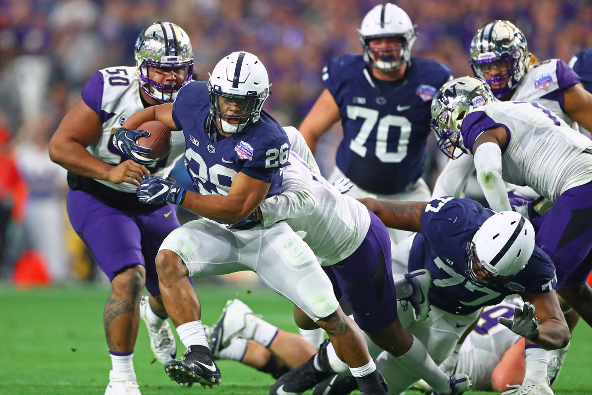
elude (v.)
Definition: to evade or escape from danger in a skillful or clever way
Synonyms: avoid

