Slide 1
Romeo & Juliet
Semester Week 11
Unit Day 8

Slide 2
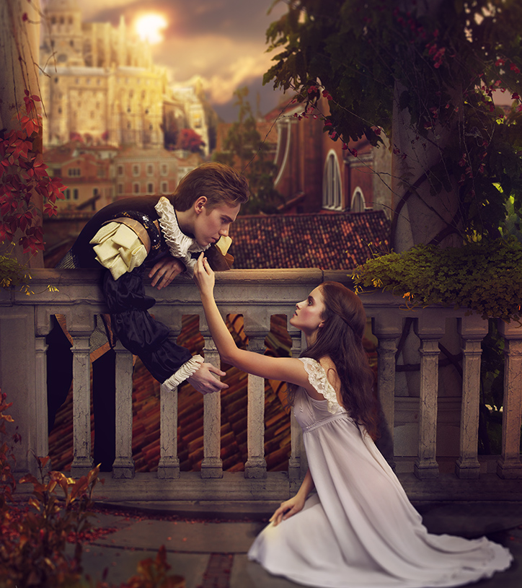
Week 11 Overview
Monday (Day 6):
Flex Day
Tuesday (Day 7):
Journal #2
Review Terms: Monologue, Soliloquy, Aside
Plot Summary Act I
Read Act I Scene v
Complete Comprehension Questions
Wednesday (Day 8):
Read Act II Prologue - Scene ii
Plot Summary Act I-II
Complete Comprehension Questions
Journal #3
Thursday (Day 9):
View Film Versions
Interact with pg 374 & 382 to compare films
Interact with Springboard pg 384-387
View Film Version
Journal #4
Friday (Day 10):
Review Terms: Foils & Dramatic Irony
Interact with Springboard pg 389 & 391
Read Act II Scene iii-vi
Plot Summary Act II
Complete Comprehension Questions
This Photo by Unknown Author is licensed under CC BY-NC-ND

Slide 3
Roman Numeral Guide
Roman Numerals
The Act is always a The Scene is always a
CAPITAL letter lowercase letter
I = 1 i = 1
II = 2 ii = 2
III = 3 iii = 3
IV = 4 iv = 4
V = 5 v = 5

Slide 4
Wednesday – Day 8
Read Act II Prologue & Scenes i-ii
Step 1: Visit No Fear Shakespeare Romeo and Juliet
Step 2: Read Act II Prologue & Scene i-ii (pg 72-94 in hardcopy)
Step 3: Answer Comprehension Questions
** Unfortunately I was not able to make copies of the comprehension questions before we left. Feel free to answer these questions digitally, in print, or just on notebook paper if that’s easiest.
Reminders, Resources & Tips
** All linked materials available on blog **
No Fear Shakespeare Act II Prologue & Scene i-ii:
https://www.sparknotes.com/nofear/shakespeare/romeojuliet/page_72/
No Fear Shakespeare Audio Companion:
https://www.youtube.com/watch?v=LMnjfMdVcUA&list=PL7dF5-pLSCUnf9Be71DK1aTbY3z3kxKzW
Attached here: Unit 4 - Romeo & Juliet\R&J Comp Questions Act II Scene i-ii.docx
Google Form Version: https://forms.gle/5RUkzFeWTDkQ9oMX9

Slide 5
Wednesday – Day 8
Complete Plot Summary & Journal #3
Step 1: Complete Plot Summary end of Act I & beginning of Act II
Step 2: Complete Journal #3 –
“How could the balcony scene be modernized to 2020?”
When responding, consider how teenagers might interact in 2020? What would be the modern day equivalent of the infamous balcony scene?
Reminders, Resources & Tips
** All linked materials available on blog **
** Find in light pink packet page 5 **
Attached here: Unit 4 - Romeo & Juliet\Plot Charts Cloze Notes.docx
Answer Key: Unit 4 - Romeo & Juliet\Plot Charts.docx
** Find in light pink packet page 7 **
Attached here: Unit 4 - Romeo & Juliet\R&J Journals.docx

