Slide 1
Romeo & Juliet
Semester Week 12
Unit Day 13

Slide 2
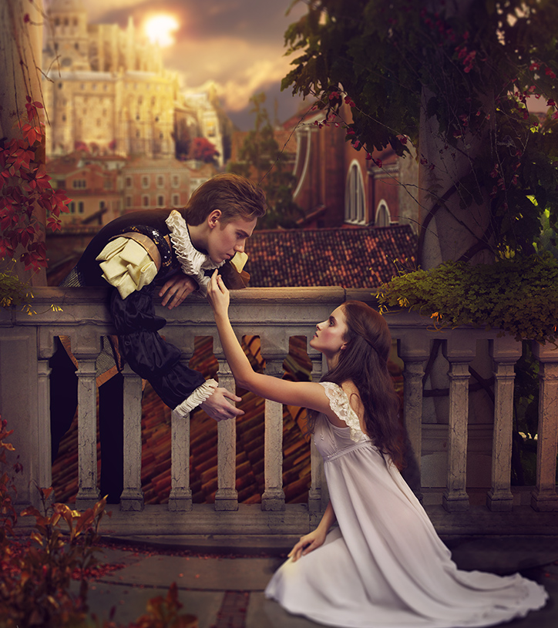
Week 12 Overview
Monday (Day 11):
Journal Day
Tuesday (Day 12):
Review Foils (watch YouTube)
Read Act III Scene I
Complete Comprehension Questions
Wednesday (Day 13):
View Film Versions Act III Scene i
Interact with Springboard pg 395 to compare films
Thursday (Day 14):
Review Terms: Monologue & Soliloquy (& Aside) (watch YouTube)
Interact with Springboard pg 399-400 (watch YouTube)
Analyze Monologue/Soliloquy
Friday (Day 15):
Read Act III Scene v
Interact with Springboard pg 402 (watch YouTube)
Complete Comprehension Questions
This Photo by Unknown Author is licensed under CC BY-NC-ND

Slide 3
Instructions to Access Springboard Digitally
Reminders, Resources & Tips
** All linked materials available on blog **
TO ACCESS SPRINGBOARD:
Step 1: Go to blog, dropdown menu “Springboard Access”
Step 2: Follow link https://clever.com/oauth/instant-login?client_id=b51b5d2ce49a6538cb55&district_id=5798a584ac8d990100000850&specify_auth=saml&t=v
Step 3: Log in ​using your Cobb County email & password ​(ex: firstname.lastname@students.cobbk12.org)
Step 4: Navigate Grade 9, Unit 5 to page numbers listed
OR
Romeo & Juliet Springboard PDF file:
Unit 4 - Romeo & Juliet\Springboard Unit 5 (Romeo and Juliet).pdf

Slide 4
Roman Numeral Guide
Roman Numerals
The Act is always a The Scene is always a
CAPITAL letter lowercase letter
I = 1 i = 1
II = 2 ii = 2
III = 3 iii = 3
IV = 4 iv = 4
V = 5 v = 5

Slide 5
Wednesday – Day 13
Film Comparison
Act III Scene i – Fight Scene
Step 1: View two versions of Act III Scene i (fight scene)
Step 2: Compare films by using Graphic Organizer on pg 395 (found in Springboard packet)
**split each box in half so you can compare both versions
Reminders, Resources & Tips
** All linked materials available on blog **
Zeffirelli Version (Act III Scene i – fight scene) → Part 1 https://www.youtube.com/watch?v=ADvHO-lGjOs
Zeffirelli Version (Act III Scene i – fight scene) → Part 2 https://www.youtube.com/watch?v=BftisZAv7tY
Luhrmann Version (Act III Scene i – fight scene) → Part 1 *Apologies for the quality of this video. It was the best I could find. https://www.youtube.com/watch?v=A3LtSLWIL5A
Luhrmann Version (Act III Scene i – fight scene) → Part 2 https://www.youtube.com/watch?v=3TMVi6WyR_I
Romeo & Juliet Springboard PDF file: Unit 4 - Romeo & Juliet\Springboard Unit 5 (Romeo and Juliet).pdf

