Slide 1
Romeo & Juliet
Semester Week 12
Unit Day 12

Slide 2
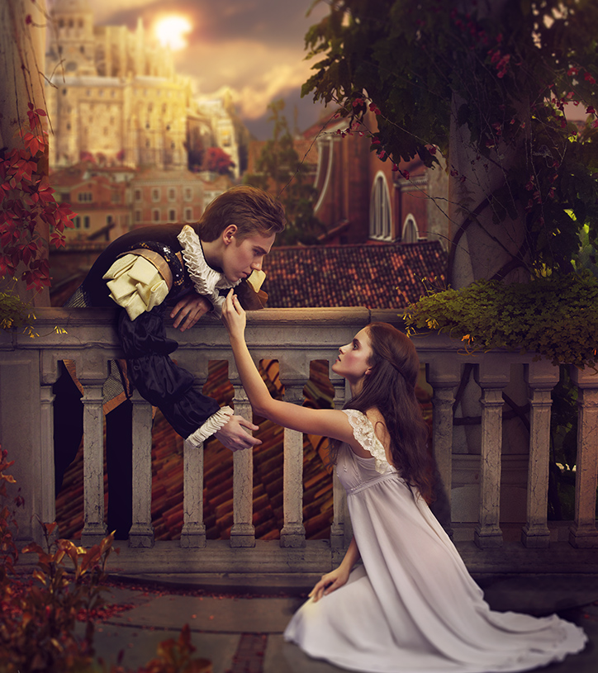
Week 12 Overview
Monday (Day 11):
Journal Day
Tuesday (Day 12):
Review Foils (watch YouTube)
Read Act III Scene I
Complete Comprehension Questions
Wednesday (Day 13):
View Film Versions Act III Scene i
Interact with Springboard pg 395 to compare films
Thursday (Day 14):
Review Terms: Monologue & Soliloquy (& Aside) (watch YouTube)
Interact with Springboard pg 399-400 (watch YouTube)
Analyze Monologue/Soliloquy
Friday (Day 15):
Read Act III Scene v
Interact with Springboard pg 402 (watch YouTube)
Complete Comprehension Questions
*AFTER BREAK
Read Act IV Scene i & iii
Interact with Springboard pg 403-404
Answer Comprehension Questions
This Photo by Unknown Author is licensed under CC BY-NC-ND

Slide 3
Instructions to Access Springboard Digitally
Reminders, Resources & Tips
** All linked materials available on blog **
TO ACCESS SPRINGBOARD:
Step 1: Go to blog, dropdown menu “Springboard Access”
Step 2: Follow link https://clever.com/oauth/instant-login?client_id=b51b5d2ce49a6538cb55&district_id=5798a584ac8d990100000850&specify_auth=saml&t=v
Step 3: Log in ​using your Cobb County email & password ​(ex: firstname.lastname@students.cobbk12.org)
Step 4: Navigate Grade 9, Unit 5 to page numbers listed
OR
Romeo & Juliet Springboard PDF file:
Unit 4 - Romeo & Juliet\Springboard Unit 5 (Romeo and Juliet).pdf

Slide 4
Roman Numeral Guide
Roman Numerals
The Act is always a The Scene is always a
CAPITAL letter lowercase letter
I = 1 i = 1
II = 2 ii = 2
III = 3 iii = 3
IV = 4 iv = 4
V = 5 v = 5

Slide 5
Tuesday – Day 12
Review Foils
Step 1: Watch YouTube video to review the term Foil & Journal #5 from last week
Journal #5:
*Read Springboard pg 389 Practice Role-Play scenarios a, b & c
“Choose one of the 3 situations and determine what the outcome would be”
Reminders, Resources & Tips
** All linked materials available on blog **
YouTube tutorial: https://youtu.be/CIdZIvMEZsI
** Find in light pink packet page 4 **
Attached here: Unit 4 - Romeo & Juliet\R&J Terms.docx
** Find in light pink packet page 7 **
Attached here: Unit 4 - Romeo & Juliet\R&J Journals.docx
Romeo & Juliet Springboard PDF file: Unit 4 - Romeo & Juliet\Springboard Unit 5 (Romeo and Juliet).pdf

Slide 6
Tuesday – Day 12
Read Act III Scene I & Answer Questions
*Act III Scene i is the very important fight scene that drives the action for the rest of the play!
Step 1: Visit No Fear Shakespeare Romeo and Juliet
Step 2: Read Act III Scene i (pg 136-152 in hardcopy)
Step 3: Answer Comprehension Questions
*Optional
Step 4: View Recap Video https://www.youtube.com/watch?v=IRHODZaSVpY
Reminders, Resources & Tips
** All linked materials available on blog **
No Fear Shakespeare Act III Scene i:
https://www.sparknotes.com/nofear/shakespeare/romeojuliet/page_136/
No Fear Shakespeare Audio Companion:
https://www.youtube.com/watch?v=M3GDZzuUdy0&list=PL7dF5-pLSCUnf9Be71DK1aTbY3z3kxKzW&index=12
Comprehension Questions: ..\Unit 4 - Romeo & Juliet\R&J Comp Questions Act III Scene i.docx
Google Forms: https://forms.gle/Ppb1TaqdRfxsTPuQA

