Slide 1
Romeo & Juliet
Semester Week 11
Unit Day 10

Slide 2
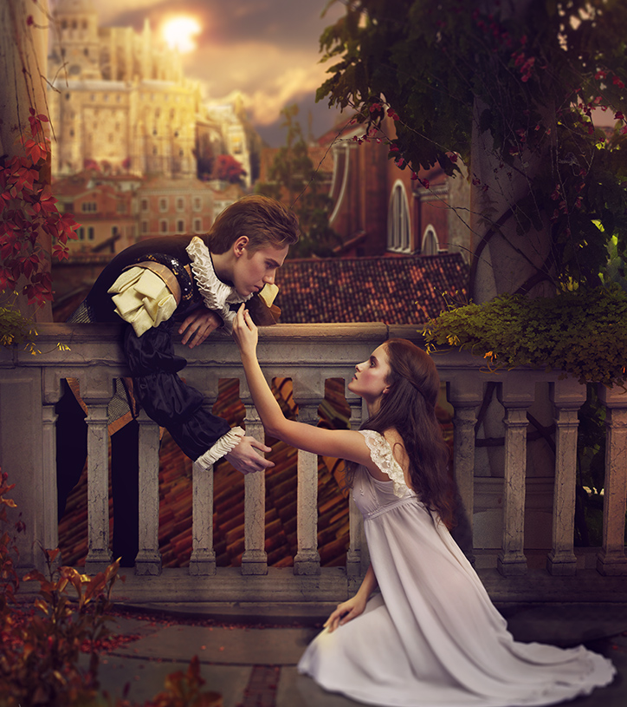
Week 11 Overview
Monday (Day 6):
Flex Day
Tuesday (Day 7):
Journal #2
Review Terms: Monologue, Soliloquy, Aside
Plot Summary Act I
Read Act I Scene v
Complete Comprehension Questions
Wednesday (Day 8):
Read Act II Prologue - Scene ii
Plot Summary Act I-II
Complete Comprehension Questions
Journal #3
Thursday (Day 9):
View Film Versions
Interact with pg 374 & 382 to compare films
Interact with Springboard pg 384-387
View Film Version
Journal #4
Friday (Day 10):
Review Terms: Foils & Dramatic Irony
Interact with Springboard pg 389 & 391
Read Act II Scene iii-vi
Plot Summary Act II
Complete Comprehension Questions
This Photo by Unknown Author is licensed under CC BY-NC-ND

Slide 3
Instructions to Access Springboard Digitally
Reminders, Resources & Tips
** All linked materials available on blog **
TO ACCESS SPRINGBOARD:
Step 1: Go to blog, dropdown menu “Springboard Access”
Step 2: Follow link https://clever.com/oauth/instant-login?client_id=b51b5d2ce49a6538cb55&district_id=5798a584ac8d990100000850&specify_auth=saml&t=v
Step 3: Log in ​using your Cobb County email & password ​(ex: firstname.lastname@students.cobbk12.org)
Step 4: Navigate Grade 9, Unit 5 to page numbers listed
OR
Romeo & Juliet Springboard PDF file:
Unit 4 - Romeo & Juliet\Springboard Unit 5 (Romeo and Juliet).pdf

Slide 4
Roman Numeral Guide
Roman Numerals
The Act is always a The Scene is always a
CAPITAL letter lowercase letter
I = 1 i = 1
II = 2 ii = 2
III = 3 iii = 3
IV = 4 iv = 4
V = 5 v = 5

Slide 5
Friday – Day 10
Journal #5, Review Terms, Plot Chart
Step 1: Review the terms Foil & Dramatic Irony
Step 2: Complete Journal #5 –
*Read Springboard pg 389 Practice Role-Play scenarios a, b & c
“Choose one of the 3 situations and determine what the outcome would be”
Step 3: Read Springboard pg 391
Step 4: Answer questions 2 & 3
Reminders, Resources & Tips
** All linked materials available on blog **
** Find in light pink packet page 4 **
Attached here: Unit 4 - Romeo & Juliet\R&J Terms.docx
** Find in light pink packet page 7 **
Attached here: Unit 4 - Romeo & Juliet\R&J Journals.docx
Romeo & Juliet Springboard PDF file: Unit 4 - Romeo & Juliet\Springboard Unit 5 (Romeo and Juliet).pdf

Slide 6
Friday – Day 10
Read Act II Scenes iii-vi & Answer Questions
Step 1: Visit No Fear Shakespeare Romeo and Juliet
Step 2: Read Act II Scene iii-vi (pg 96-134 in hardcopy)
Step 3: Answer Comprehension Questions
Step 4: Complete Plot Summary Act II
** Unfortunately I was not able to make copies of the comprehension questions before we left. Feel free to answer these questions digitally, in print, or just on notebook paper if that’s easiest.
Reminders, Resources & Tips
** All linked materials available on blog **
No Fear Shakespeare Act II Scene iii-vi:
https://www.sparknotes.com/nofear/shakespeare/romeojuliet/page_96/
No Fear Shakespeare Audio Companion:
https://www.youtube.com/watch?v=LMnjfMdVcUA&list=PL7dF5-pLSCUnf9Be71DK1aTbY3z3kxKzW
Attached here: Unit 4 - Romeo & Juliet\R&J Comp Questions Act II Scene iii-vi.docx
Google Form Version: https://forms.gle/uHcUgw2cviDtnhqbA
** Find in light pink packet page 5 **
Attached here: Unit 4 - Romeo & Juliet\Plot Charts Cloze Notes.docx
Answer Key: Unit 4 - Romeo & Juliet\Plot Charts.docx

