Slide 1
Characterization Study
Semester Week 16
Thursday 5/7/20

Slide 2
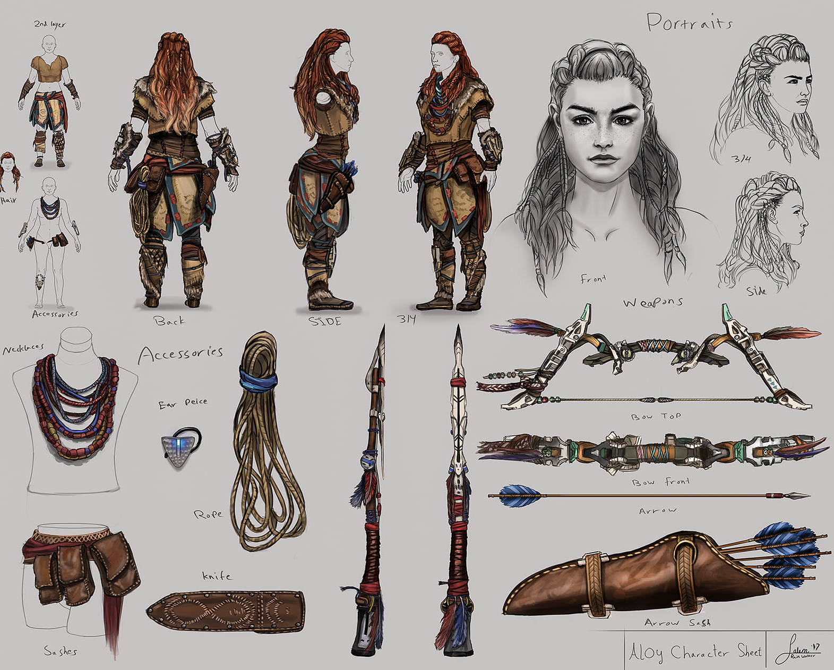
Weekly Overview
Monday
Writer’s Notebook
Complete Characterization Activity
Tuesday
Writer’s Notebook
Review of Indirect vs. Direct Characterization
Examine Sample Monologues
Wednesday
Writer’s Notebook
View Movie Monologues
Thursday
Writer’s Notebook
Analyze or Perform a Monologue
Friday
Catch Up Day!
This Photo by Unknown Author is licensed under CC BY-NC-ND

Slide 3
Writer’s Notebook
5/7/20
Make a ‘TO Read/To Watch’ list.
Find books, movies, and TV shows that you would like to read/watch. This way, whenever you are bored, you have something to do.
After you make your list, rank them in order or interest.
Finally, start checking things off!
This Photo by Unknown Author is licensed under CC BY
This Photo by Unknown Author is licensed under CC BY-SA-NC

Slide 4
Literary Analysis: Monologue Assignment
This week’s assignment focuses on literary analysis of a monologue. You have two choices. Depending on where you would like the grade: Reading Category OR Speaking and Listening
Yesterday: You completed Step 1 – Choose a monologue
TODAY: You will complete Step 2 – Analyze the monologue

Slide 5
Step 1: View monologue options & choose one
*Rose’s monologue from the play Fences – video linked here *Cher’s monologue from the movie Clueless – video linked here *Sean’s monologue from the movie Good Will Hunting (*language alert) – video linked here
Full written text of monologues included at end of PPT

Slide 6
Step 2: Analyze monologue (choose assignment option)
Complete ONE of the following assignments for the monologue you have chosen:
Speaking & Listening Category – Perform the monologue via FlipGrid considering all the elements of performance delivery learned this week. → https://flipgrid.com/ef0ff4df
Reading Category – Short Answer responses to the questions below: (In Google Drive)
What are two visual delivery elements the speaker used and why?
What are two vocal delivery elements the speaker used and why?
Make two inferences about the scenario.
If you were to perform this monologue, what are 2 specific performance choices (visually or vocally) you would do differently to make it your own?

Slide 7
Step 2: Analyze monologue (choose assignment option)
Requirements:
Speaking & Listening Category - For your performance of the monologue, use performance elements that you’ve learned this week. The choices you make in the performance of the monologue should demonstrate your understanding of the monologue.
Reading Category - For the short answer questions, respond in 3-4 sentences for each question. Use complete sentences and details/examples to support your ideas. Your answers should demonstrate your understanding of the monologue.

Slide 8
Rose’s monologue from fences
ROSE: I been standing with you! I been right here with you, Troy. I got a life too. I gave eighteen years of my life to stand in the same spot with you. Don’t you think I ever wanted other things? Don’t you think I had dreams and hopes? What about my life? What about me? Don’t you think it ever crossed my mind to want to know other men? That I wanted to lay up somewhere and forget about my responsibilities? That I wanted someone to make me laugh so I could feel good? You not the only one who’s got wants and needs. But I held on to you, Troy. I took all my feelings, my wants and needs, my dreams…and I buried them inside you. I planted a seed and watched and prayed over it. I planted myself inside you and waited to bloom. And it didn’t take me no eighteen years to find out the soil was hard and rocky and it wasn’t never gonna bloom.
But I held on to you, Troy. I held you tighter. You was my husband. I owed you everything I had. Every part of me I could find to give you. And upstairs in that room…with the darkness falling in on me…I gave everything I had to try and erase the doubt that you wasn’t the finest man in the world. And wherever you was going…I wanted to be there with you. Cause you was my husband. Cause that’s the only way I was gonna survive as your wife. You always talking about what you give…and what you don’t have to give. But you take, too. You take…and don’t even know nobody’s giving!

Slide 9
Cher’s monologue from Clueless
Cher: So, OK, like right now, for example, the Haitians need to come to America. But some people are all "What about the strain on our resources?" But it's like, when I had this garden party for my father's birthday right? I said R.S.V.P. because it was a sit-down dinner. But people came that like, did not R.S.V.P. so I was like, totally buggin'. I had to haul ass to the kitchen, redistribute the food, squish in extra place settings, but by the end of the day it was like, the more the merrier! And so, if the government could just get to the kitchen, rearrange some things, we could certainly party with the Haitians. And in conclusion, may I please remind you that it does not say R.S.V.P. on the Statue of Liberty?

Slide 10
Sean’s monologue from Good Will Hunting
Sean: So if I asked you about art you’d probably give me the skinny on every art book ever written. Michelangelo? You know a lot about him. Life’s work, political aspirations, him and the pope, sexual orientation, the whole works, right? But I bet you can’t tell me what it smells like in the Sistine Chapel. You’ve never actually stood there and looked up at that beautiful ceiling. Seen that. If I asked you about women you’d probably give me a syllabus of your personal favorites. You may have even been laid a few times. But you can’t tell me what it feels like to wake up next to a woman and feel truly happy. You’re a tough kid. I ask you about war, and you’d probably, uh, throw Shakespeare at me, right? ‘Once more into the breach, dear friends.’ But you’ve never been near one. You’ve never held your best friend’s head in your lap and watched him gasp his last breath, looking to you for help. And if I asked you about love you probably quote me a sonnet. But you’ve never looked at a woman and been totally vulnerable. Known someone could level you with her eyes. Feeling like God put an angel on earth just for you…who could rescue you from the depths of hell. And you wouldn’t know what it’s like to be her angel and to have that love for her to be there forever. Through anything. Through cancer. You wouldn’t know about sleeping sitting up in a hospital room for two months holding her hand because the doctors could see in your eyes that the term visiting hours don’t apply to you. You don’t know about real loss, because that only occurs when you love something more than you love yourself. I doubt you’ve ever dared to love anybody that much. I look at you; I don’t see an intelligent, confident man; I see a cocky, scared shitless kid. But you’re a genius, Will. No one denies that. No one could possibly understand the depths of you. But you presume to know everything about me because you saw a painting of mine and you ripped my fuckin’ life apart. You’re an orphan right? Do you think I’d know the first thing about how hard your life has been, how you feel, who you are because I read Oliver Twist? Does that encapsulate you? Personally, I don’t give a shit about all that, because you know what? I can’t learn anything from you I can’t read in some fuckin’ book. Unless you wanna talk about you, who you are. And I’m fascinated. I’m in. But you don’t wanna do that, do you, sport? You’re terrified of what you might say. Your move, chief.

