Slide 1
Characterization Study
Semester Week 16
Tuesday 5/5/20

Slide 2
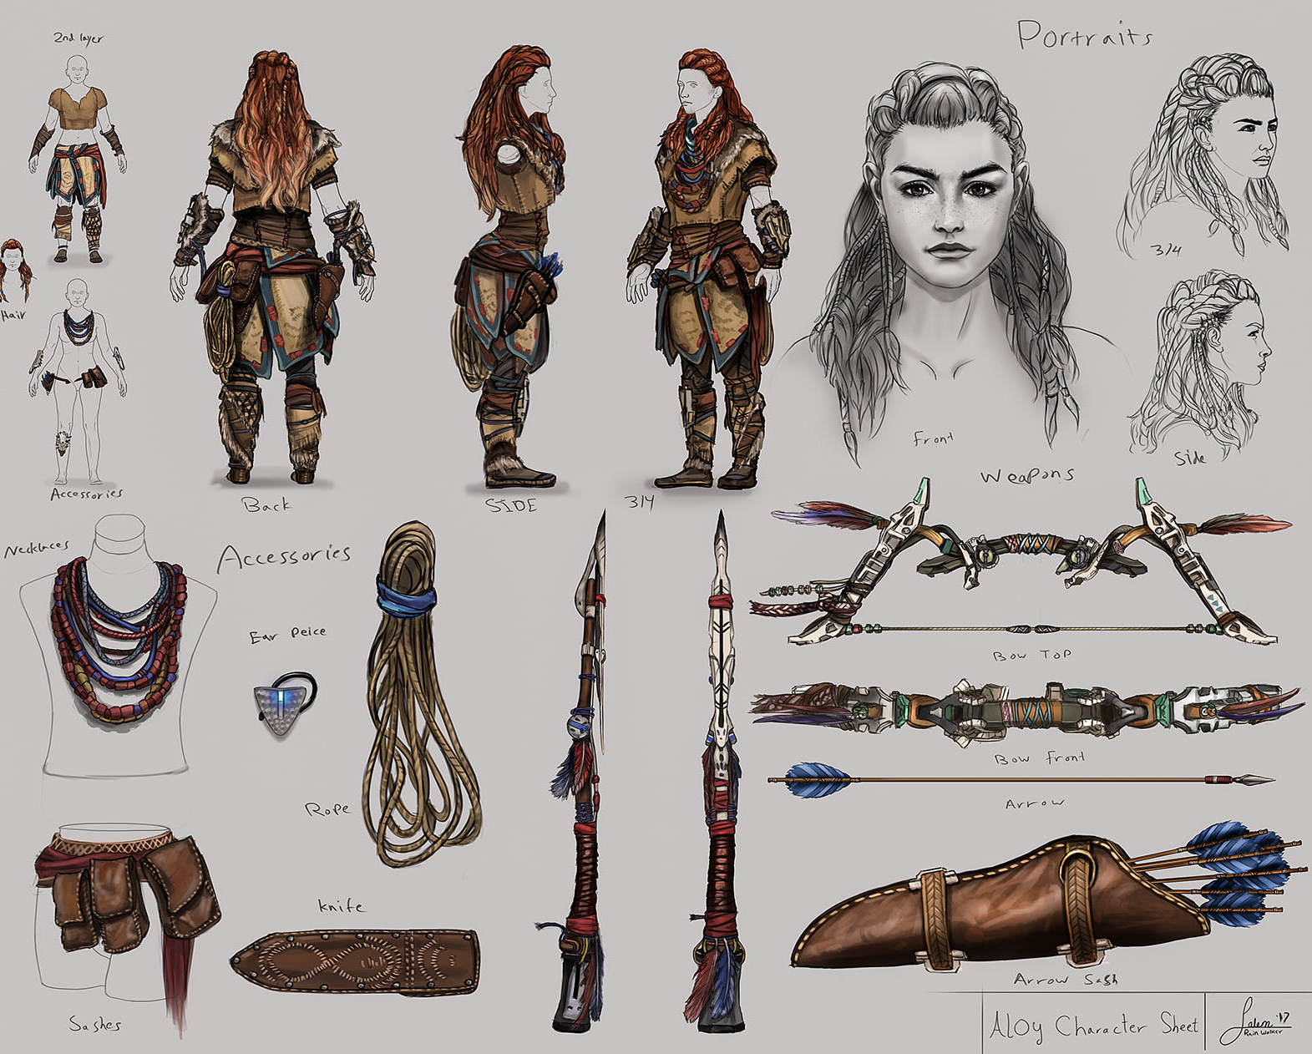
Weekly Overview
Monday
Writer’s Notebook
Complete Characterization Activity
Tuesday
Writer’s Notebook
Review of Indirect vs. Direct Characterization
Examine Sample Monologues
Wednesday
Writer’s Notebook
View Movie Monologues
Thursday
Writer’s Notebook
Analyze or Perform a Monologue
Friday
Catch Up Day!
This Photo by Unknown Author is licensed under CC BY-NC-ND

Slide 3
Submitted by Sarah Jane Eggers
Writer’s Notebook
5/5/20
How Lucky are We?
Look around you. During this pandemic you may think, “we are so unlucky” but there is so much to be thankful for.
Find ten things around, whether those things are family members, the roof over your head, or objects.
Write a list with a description explaining why you chose your ten items.
After you are done, I hope that you will see the situation we are in a little bit differently.

Slide 4
Characterization Study
Review the activity from yesterday by watching the instructional video about Direct vs. Indirect Characterization
Access Video here
https://cobbk12org-my.sharepoint.com/:v:/g/personal/sylvia_spruill_cobbk12_org/EdAuuC-zHwlKveCMxzTpFewByYhrklmeP_68HR4nr_TJSg?e=MCzCHx

Slide 5
Monologue Study
Instructional Video
Today we will learn more about monologues by reviewing some literary terms associated with monologues, then viewing and analyzing two example monologues.
View the instructional video (20 min) and take notes while you watch. Notes can be taken digitally or on the Springboard/Monologue resources attached.
Instructional Video → https://cobbk12org-my.sharepoint.com/:v:/g/personal/sylvia_spruill_cobbk12_org/Eaj2ejIWbwdLuo72Cl4rODgBOFjOkDDzCZBEbpV5ahsbVg?e=Gkahz7

Slide 6
Monologue Study
Additional Resources
The Instructional Video contains all information – the attached resources are optional to make note taking easier
Springboard PDF → https://drive.google.com/file/d/1LXCFoyxl0PRb5u5XvK9WsrJXcDqq_14i/view?usp=sharing
Hidden Figures Video Clip → https://www.youtube.com/watch?v=9j6p7ajuh-E&t=3s
Hidden Figures Monologue → https://drive.google.com/file/d/1zftH0Ohw2DKXn8cDKS_53B7NNZzf51K2/view?usp=sharing
Fresh Prince Video Clip → https://www.youtube.com/watch?v=PI4Mv8R0mE0
Fresh Prince Monologue → https://drive.google.com/file/d/1pHGQWMmxapkHEbnYNrWJ5yDHgfYyXDLu/view?usp=sharing

