Slide 1
Narrative Writing Study
Semester Week 17
Thursday 5/14/20

Slide 2
Weekly Overview
Monday
Writer’s Notebook
Read Kaffir Boy and Answer Questions
Focus: Dialogue
Tuesday
Writer’s Notebook
View Sanjay’s Superteam
Add Dialogue
Wednesday
Writer’s Notebook
Read Pick One and Answer Questions
Focus: Pacing
Thursday
Writer’s Notebook
Writing Assignment
Friday
Catch Up Day!
This Photo by Unknown Author is licensed under CC BY
* Optional: Zinc Article for reading grade & Zinc Vocab Activity for Language grade
* Available Tuesday 5/12 – Friday 5/15

Slide 3
Optional Activities
Reading Grade
Zinc Article “Searching for My Grandmother’s Cooking”
Only complete multiple choice; do not complete writing activity
Vocabulary Grade
Zinc Vocab set: Digital Learning Academic Terms
Review the words and then complete the activity

Slide 4
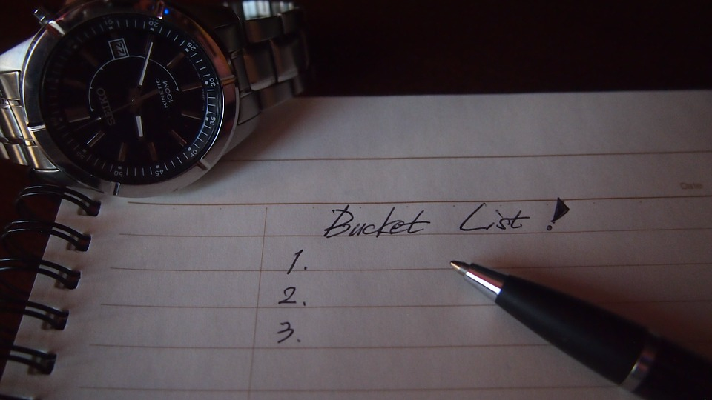
Writer’s Notebook 5/14/20
Write out a bucket list.
What have you always wanted to do/see/learn/experience?
Choose at least one of those things to check off this summer!

Slide 5
* Yesterday you learned about Pacing and read Pick One by David Matthews SB pgs → https://drive.google.com/file/d/1gwLSNlGftM84nViR7MGZEpqZ52sfVtc1/view?usp=sharing * Review the ANSWER KEY to check your answers https://drive.google.com/file/d/1Qh18GBd0M3cGo_t9fjRWYN5B_FUDodxG/view?usp=sharing
PICK ONE

Slide 6
This week’s assignment focuses on narrative writing and the writing tools that can be effectively used to write one. You have three topic choices. This will be a grade in the writing category.
Narrative Writing

Slide 7
Instructions:
After completing the daily assignments for Monday, Tuesday, and Wednesday, you will choose ONE of the following narrative prompts to respond to:
Write a narrative about a memorable experience from your own childhood that illustrates one perspective or attitude that your family has. Consider the impact your family had on your experience.
Write a narrative about a time when you made an important decision about yourself.
Write a narrative about a particularly memorable and/or life-changing moment during the recent quarantine. Remember this should be something unique and meaningful to you. Keep in mind we’ve all been quarantined and have had similar changes. What makes this moment particularly significant and worth sharing?

Slide 8
Guidelines:
Introduce the setting for the narrative.
Provide a well-structured sequence of events and a conclusion that reflects on the impact of the experience.
Incorporate direct and indirect dialogue to aid in the development of your narrative and punctuate dialogue correctly.
Use precise words and phrases and sensory language.
Use descriptive details to help the reader understand your story.
Provide a smooth progression of experiences or events, using transitions to move through the story.
Vary the pacing using details and sentence types and lengths.
*Approximate length: 600-700 words (roughly 2 pages double spaced)
*To identify word count highlight passage, go to “Review” or “Tools” depending on the version of word you are using, then click the “word count” option and it will tell you the total number of words typed

