Slide 1
Narrative Writing Study
Semester Week 17
Tuesday 5/12/20

Slide 2
Weekly Overview
Monday
Writer’s Notebook
Read Kaffir Boy and Answer Questions
Focus: Dialogue
Tuesday
Writer’s Notebook
View Sanjay’s Superteam
Add Dialogue
Wednesday
Writer’s Notebook
Read Pick One and Answer Questions
Focus: Pacing
Thursday
Writer’s Notebook
Writing Assignment
Friday
Catch Up Day!
This Photo by Unknown Author is licensed under CC BY
* Optional: Zinc Article for reading grade & Zinc Vocab Activity for Language grade
* Available Tuesday 5/12 – Friday 5/15

Slide 3
Optional Activities
Reading Grade
Zinc Article “Searching for My Grandmother’s Cooking”
Only complete multiple choice; do not complete writing activity.
Vocabulary Grade
Zinc Vocab set: Digital Learning Academic Terms
Review the words and then complete the activity

Slide 4
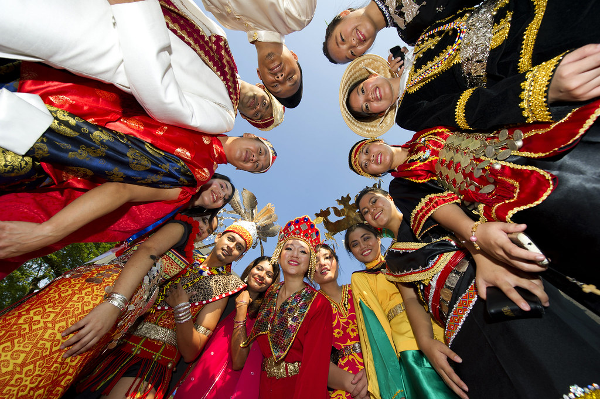
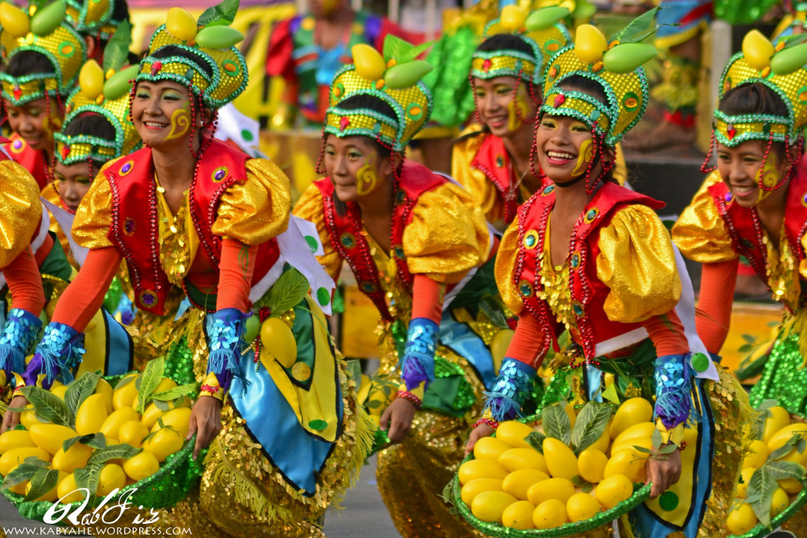
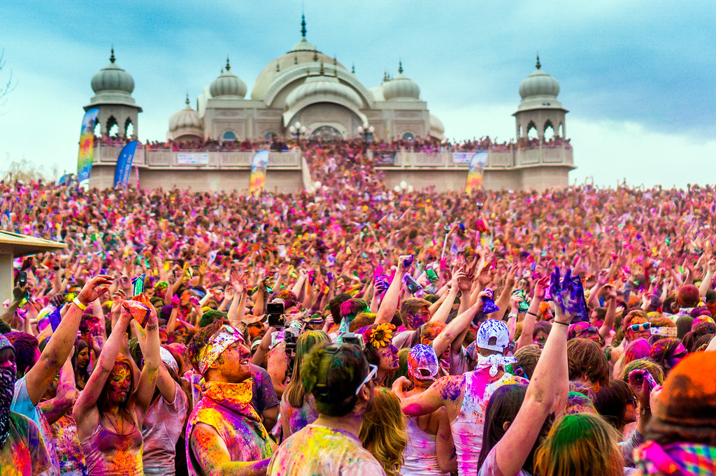
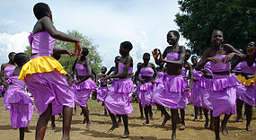
Writer’s Notebook 5/12/20
Create a brand-new holiday with its own traditions, rituals, foods, clothing and activities.
Is there a historical event you feel we should celebrate?
Something or someone we should appreciate?
Feel encouraged to include a sketch!
This Photo by Unknown Author is licensed under CC BY-SA
This Photo by Unknown Author is licensed under CC BY-NC-ND
This Photo by Unknown Author is licensed under CC BY-SA
This Photo by Unknown Author is licensed under CC BY-NC-ND

Slide 5
* Yesterday you learned about Direct vs Indirect Dialogue and read Kaffir Boy by Mark Mathabane SB pgs → https://drive.google.com/file/d/1Q-a2nL1fkKC828uZoBCWY88HCwH0gkih/view?usp=sharing * Watch this video to review these terms and the questions from yesterday https://cobbk12org-my.sharepoint.com/:v:/g/personal/sylvia_spruill_cobbk12_org/ETpEG9MIB1VIp9ZDwmyQAz8Byn9S2F0J1naEs8_rkukDXA?e=jaBUbS
KAFFIR BOY

Slide 6
*Notice that there is no dialogue in this short film *Practice writing direct, indirect & internal dialogue by adding conversation to the short film. *Where do you think dialogue might enhance the story? *Be sure to consider how these characters would speak (Sanjay vs Dad) and to use strong diction when writing dialogue tags.
Sanjay’s Super Team
View this video → https://dovga.com/video/8152/sanjays-super-team
(link must be viewed with Chrome – video does not work on Edge – video also available on Disney + )

Slide 7
Sanjay’s Super Team Dialogue Practice
When writing dialogue, use this list to help you with dialogue tags!

